Slide 1
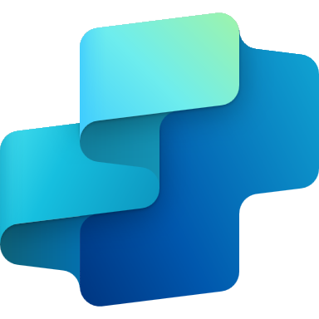

Implementation Guide
Copilot Studio
Workshop date: YYYY-MM-DD

Slide 2
Success by Design
Success by Design is Microsoft’s framework for Power Platform implementations
Faster Deployment
The framework is designed around 3 principles:
Early Discovery
Proactive Guidance
Predictable Success
Maximized ROI
Higher Adoption
Success by Design brings the learnings and experiences from thousands of customer deployments to make your journey to the cloud smoother, faster and successful.

Slide 3







Typical Success by Design engagement lifecycle
Initiate
Implement
Prepare
Operate
Get ready to start
Design
Build
Deploy
Live
Kick-off
Go-Live
Regular touchpoints
Go-live readiness checks
Success story publishing
Implementation Review
Submit your story here: aka.ms/ShareAIStory
Deep-dive architecture discussions
Roadblock identification & mitigation
Preview discussions & participation

Slide 4
Implementation Guide
Agenda
The objective is to understand the various aspects of the project and provide recommendations, guidance, best practices, and highlight any risks or gaps in the plan. It is also an opportunity to discuss product roadmap and release alignment.
Project overview
Architecture overview
Language understanding
AI capabilities
Attendees: key stakeholders from the customer and partner: project leads, solution architects, functional and technical leads.
Requirements: filling the implementation review document, at least partially. If needed, the content can be reviewed and discussed in multiple sessions throughout the implementation.
Out of scope: defining a solution architecture based on the review, providing product training, or performing code reviews.
Integrations
Channels, clients, and hand off
Security, monitoring & governance
Application lifecycle management
Analytics & KPIs
Fit-gap & top requests
Dynamics 365 Omnichannel (optional)

Slide 5
Instructions for customers and partners
How to fill this document:
Complete each slide providing the required information
Post-it notes should be removed: their purpose is only to provide example answers.
Skip and hide slides that are not applicable to your project.
Add more slides to capture the required information if needed.
Do not hesitate to paste your own slides and existing content.
Reach out if you have questions on the format or content.
Send the completed deck before the review workshops.
Store the document in a shared SharePoint location if possible.
Feedback on this guide? Share it here

Slide 6
Project Overview
Business overview
Project overview & agent purpose
Stakeholders
Project planning
Target KPIs
Assumption & concerns

Slide 7
Why agents?
Agents are the new chatbots
Throughout this document, we refer to agents instead of bots or chatbots. This reflects the new branding of agents.
Microsoft Copilot Studio is an end-to-end conversational AI platform that empowers you to create and customize agents using natural language or a graphical interface. With Copilot Studio, you can easily design, test, and publish agents that suit your specific needs for internal or external scenarios across your industry, department, or role.
With more immersive UX and next-generation AI capabilities, agents are the new chatbots.

Slide 8

Why do we ask these questions?
Knowing more about your organization and business unit helps us better understand your use cases.
Depending on your industry, we may have specific guidance or share similar implementation patterns.
Information we’re looking for:
Overview of your organization.
Feel free to include logos and key metrics (number of employees, revenue, etc.).
If the project applies to a specific subsidiary, business unit, department or team, please also describe it here.
Business overview
Provide an overview of your organization with a focus on your business unit
Example answer (you can delete this)
Contoso Corporation is a fictional but representative global manufacturing conglomerate with its headquarters in Paris.
2022 key figures:
40k employees
16 countries
$20B revenue in 2022
The Global Modern Workplace department is a team of 100 reporting to the CDO and is responsible for the modernization of workforce tools and processes across the company. One of the key principles of the modernization strategy is to use low code solutions and AI to empower employees and help them achieve more and be more productive.

Slide 9
Why do we ask these questions?
Understanding the project and what problem your agent is trying to solve is key to make relevant recommendations or share similar implementation patterns.
Knowing who your end-users are will also be useful to understand the agent deployment channels requirements.
Information we’re looking for:
What are the current business challenges that this project will help address?
What is the purpose and main features of the agent?
Who are the end-users of the agent?
Is this a migration project?
Project overview & agent purpose
Provide an overview of the project and the business problems the agent is trying to solve
Example answer (you can delete this)
Enterprise information is disseminated across the organization and maintained in silos that different teams are responsible for. An internal employee survey revealed a high dissatisfaction about the time spent to find answers internally.
The Employee agent is planned to be available to all 40k Contoso Corporation employees in Microsoft Teams as an app and in the global internal portal as a chatbot.
The agent is expected to leverage AI and existing knowledge sources to answer employee questions on HR, IT, Sales and Finance topics. Answers must be grounded and sourced in enterprise data locations (SharePoint, ServiceNow, Dynamics 365, SAP).
Employees can also use the agent to perform common actions such as unlocking an account or booking meeting rooms.

Slide 10
Why do we ask these questions?
This helps us know who the key stakeholders are for the projects.
The Microsoft team can also be described below.
Microsoft Team
Account Executive
[John Doe jdoe@microsoft.com]
Account Technology Strategist
[John Doe jdoe@microsoft.com]
Customer Success Account Manager
[John Doe jdoe@microsoft.com]
Sales Specialist
[John Doe jdoe@microsoft.com]
Technical Specialist
[John Doe jdoe@microsoft.com]
Cloud Solution Architect
[John Doe jdoe@microsoft.com]
Engineering Sponsor
[John Doe jdoe@microsoft.com]
Power CAT Program Manager
[John Doe jdoe@microsoft.com]
FastTrack Solution Architect
[John Doe jdoe@microsoft.com]
Key stakeholders
Customer, Partner and Microsoft teams
Customer team
Role | Name | Email | Title
Business Sponsor | [Jane Doe] | [jane.doe@contoso.com] | [CIO]
Project Lead
Product Owner
Technical Lead
Solution Architect
Conversation Designer
Tenant Admin
Partner team (if applicable)
Role | Name | Email | Title
Project Manager | [John Smith] | [john.smith@fabrikam.com] | [Program Lead]
Architect
Developer
Functional Consultant

Slide 11
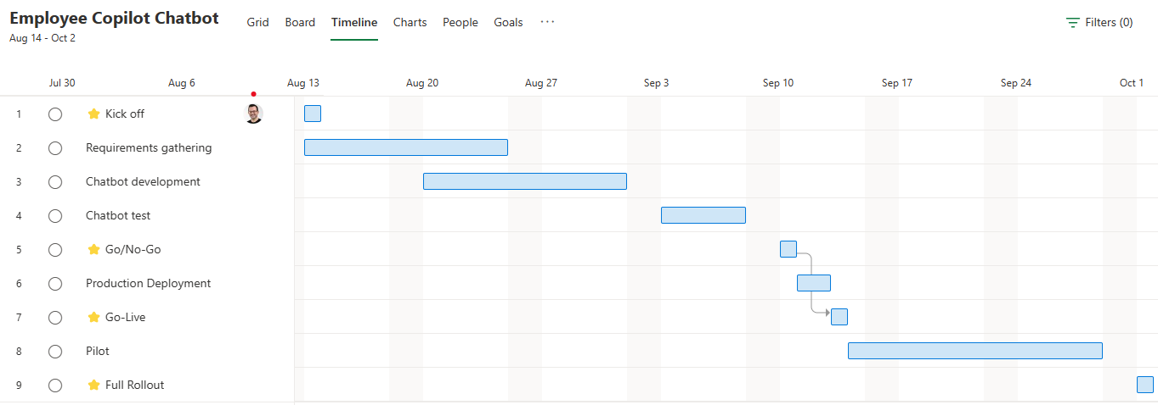
Why do we ask these questions?
Understanding the project key milestones and planned go-live dates will help setup meetings accordingly.
Information we’re looking for:
Please provide your project timeline, with target dates for major milestones.
Feel free to paste your current project planning.
Planning
What is the project timeline, from start to go-live, and the major milestones?
Example answer (you can delete this)
Kick off with business, technical and partner stakeholders on 8/1.
Phased rollout of the agent to 1,000 users in a 2-week pilot before global deployment to all 40k employees.

Slide 12





Why do we ask these questions?
To make relevant recommendations, we need to understand what success means for your agents and project.
Information we’re looking for:
How is the agent expected to help your end-users and lower the support cost?
How is end-user satisfaction expected to increase with the agent?
Is there a specific return on investment you’re expecting from this project?
Are there other metrics you’re looking to track?
Target KPIs
What are the success metrics for the project, and what are their targets?
Example answer (you can delete this)
60% deflection rate: end-user conversations leading to a resolution without any human intervention (today 20%).
4.5+ CSAT score: high satisfaction from end-users (today 3.0).
20,000 conversations / month: employees are expected on average to use the agent once every two months (today 5,000).
$1m. support savings/year: cost of ticket handling and human support avoided through automation.
Same-day updates and deployments: business subject matter experts can autonomously update, test and deploy the agent.

Slide 13
Why do we ask these questions?
Understanding your assumptions and concerns to help you either validate or address them early in the project.
Assumptions & concerns
About the capabilities of your agent:
What are your assumptions?
What are your concerns?
Example answer (you can delete this)
Out-of-the-box deployment capabilities across all channels, including WhatsApp, Slack, and SharePoint intranet pages.
Generative AI is expected to fully remove the need to maintain knowledge within the agent itself.
In the era of large language models (LLMs), state of the art intent recognition and entity extraction.
Example answer (you can delete this)
Limited control of the answers generated by a large language model (LLM).
Internal employee pushback about copilots replacing or reducing customer service teams.
Some IT teams would prefer to host the conversational AI software and LLMs on internal servers.

Slide 14
Architecture Overview
Solution architecture
Conversation volumes
Performance
Identified technical challenges

Slide 15
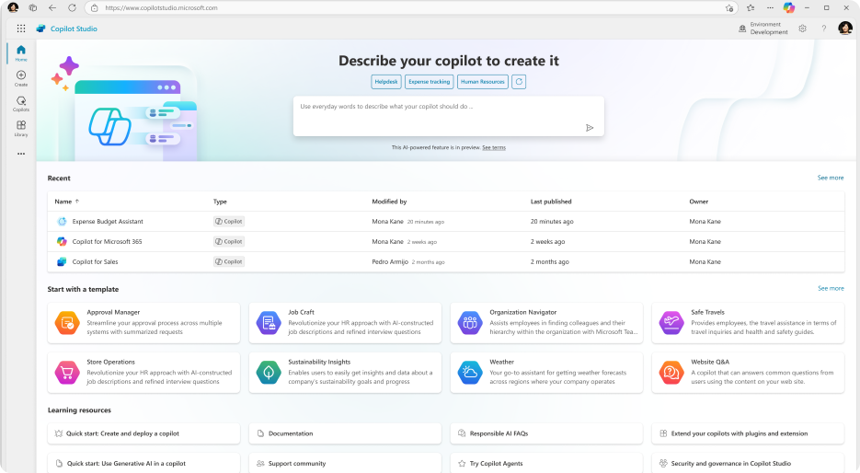
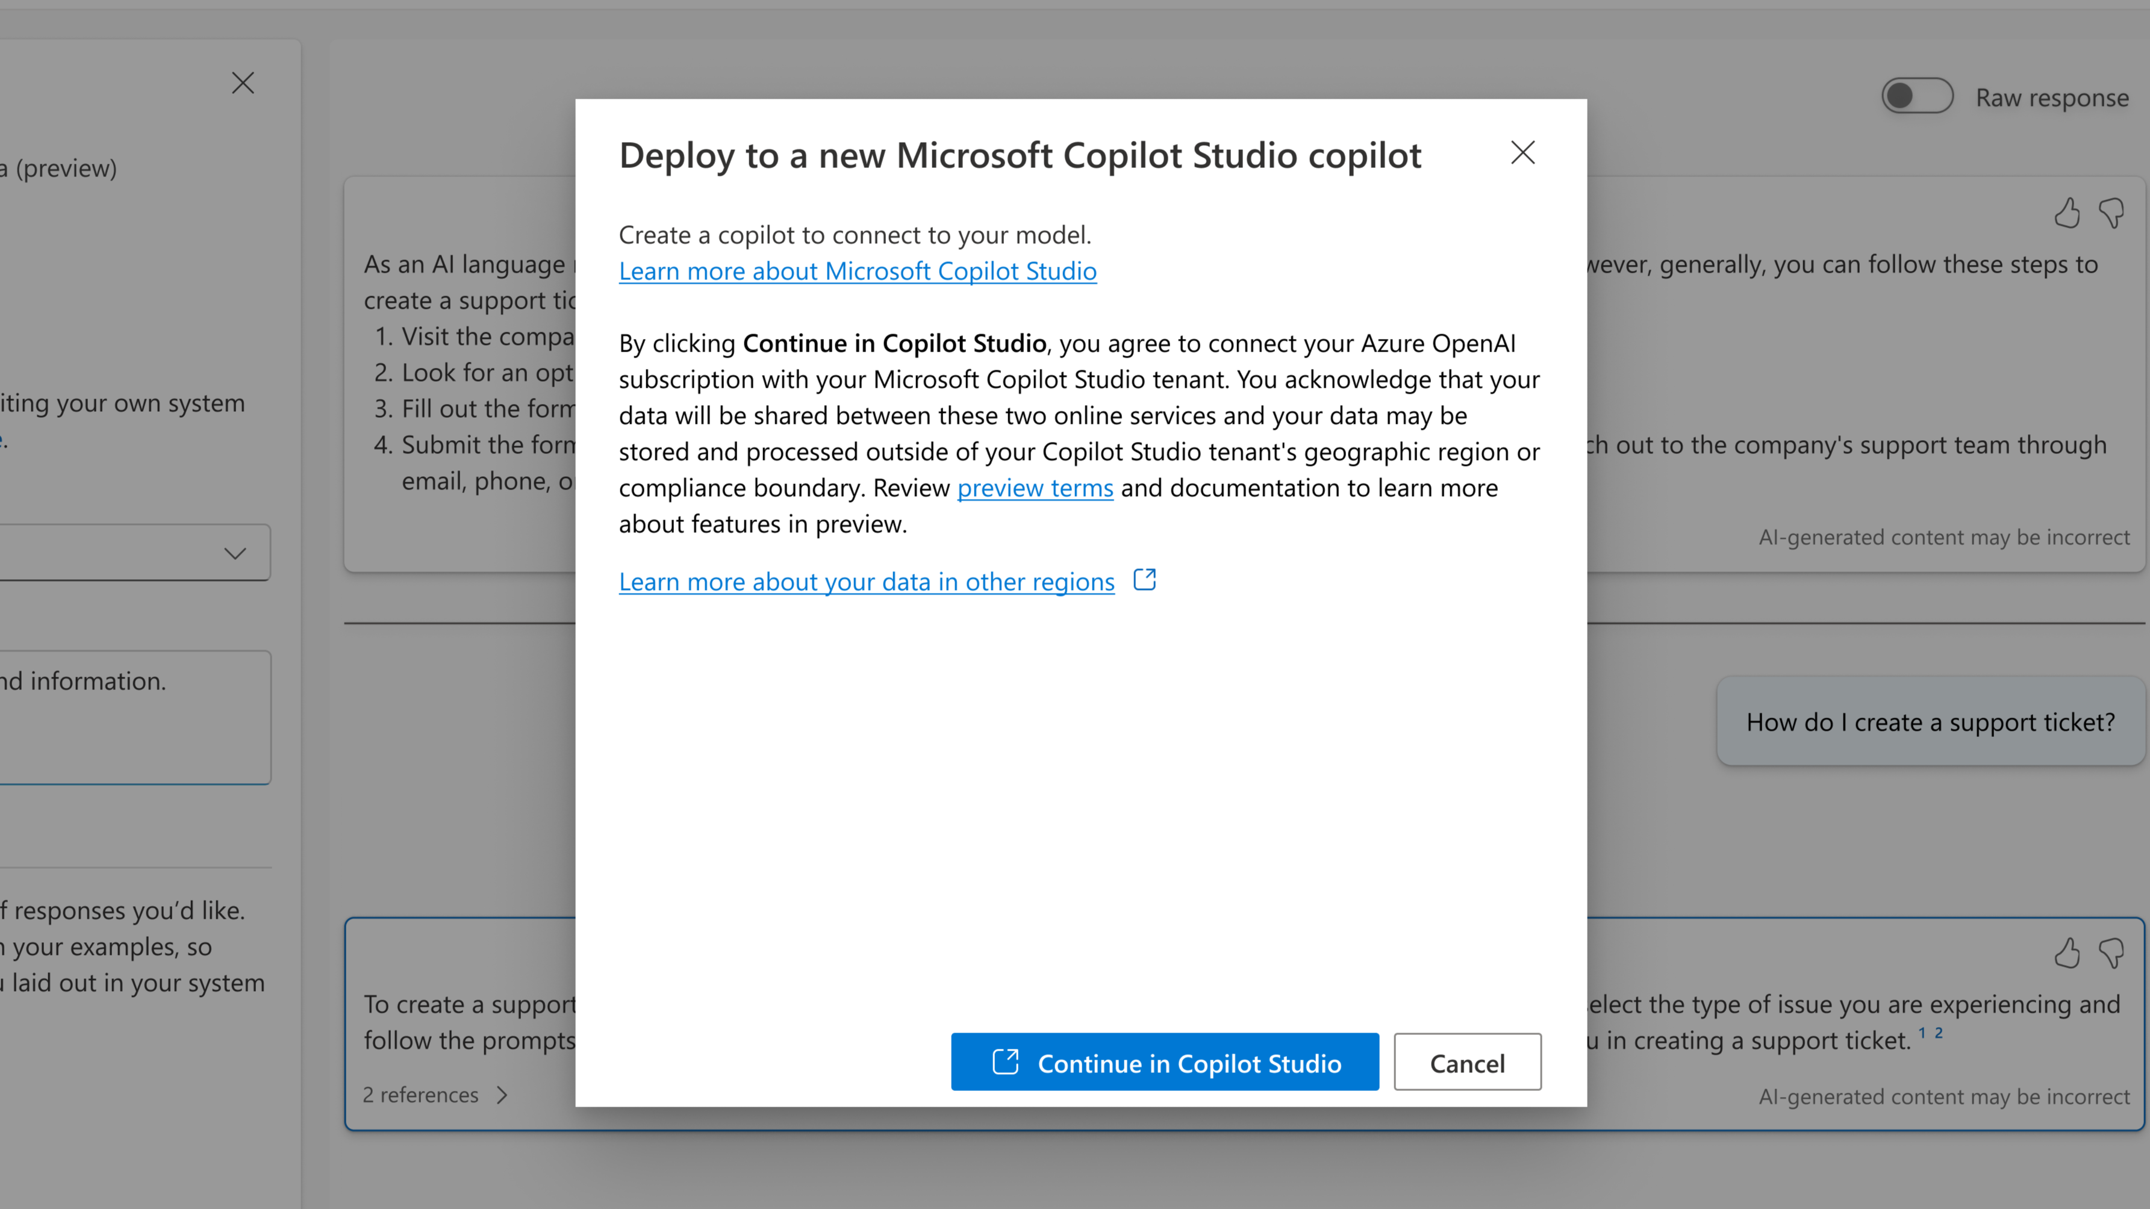
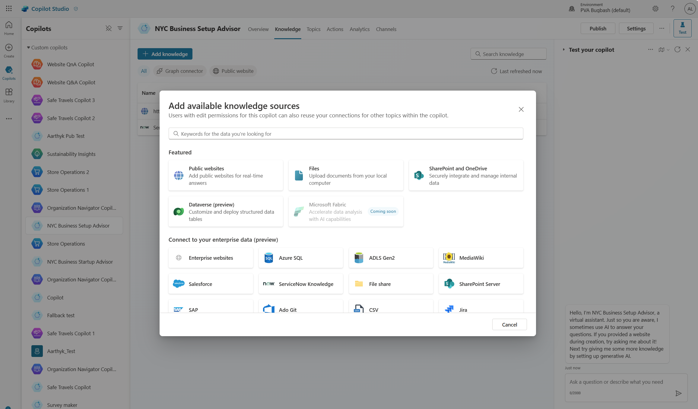
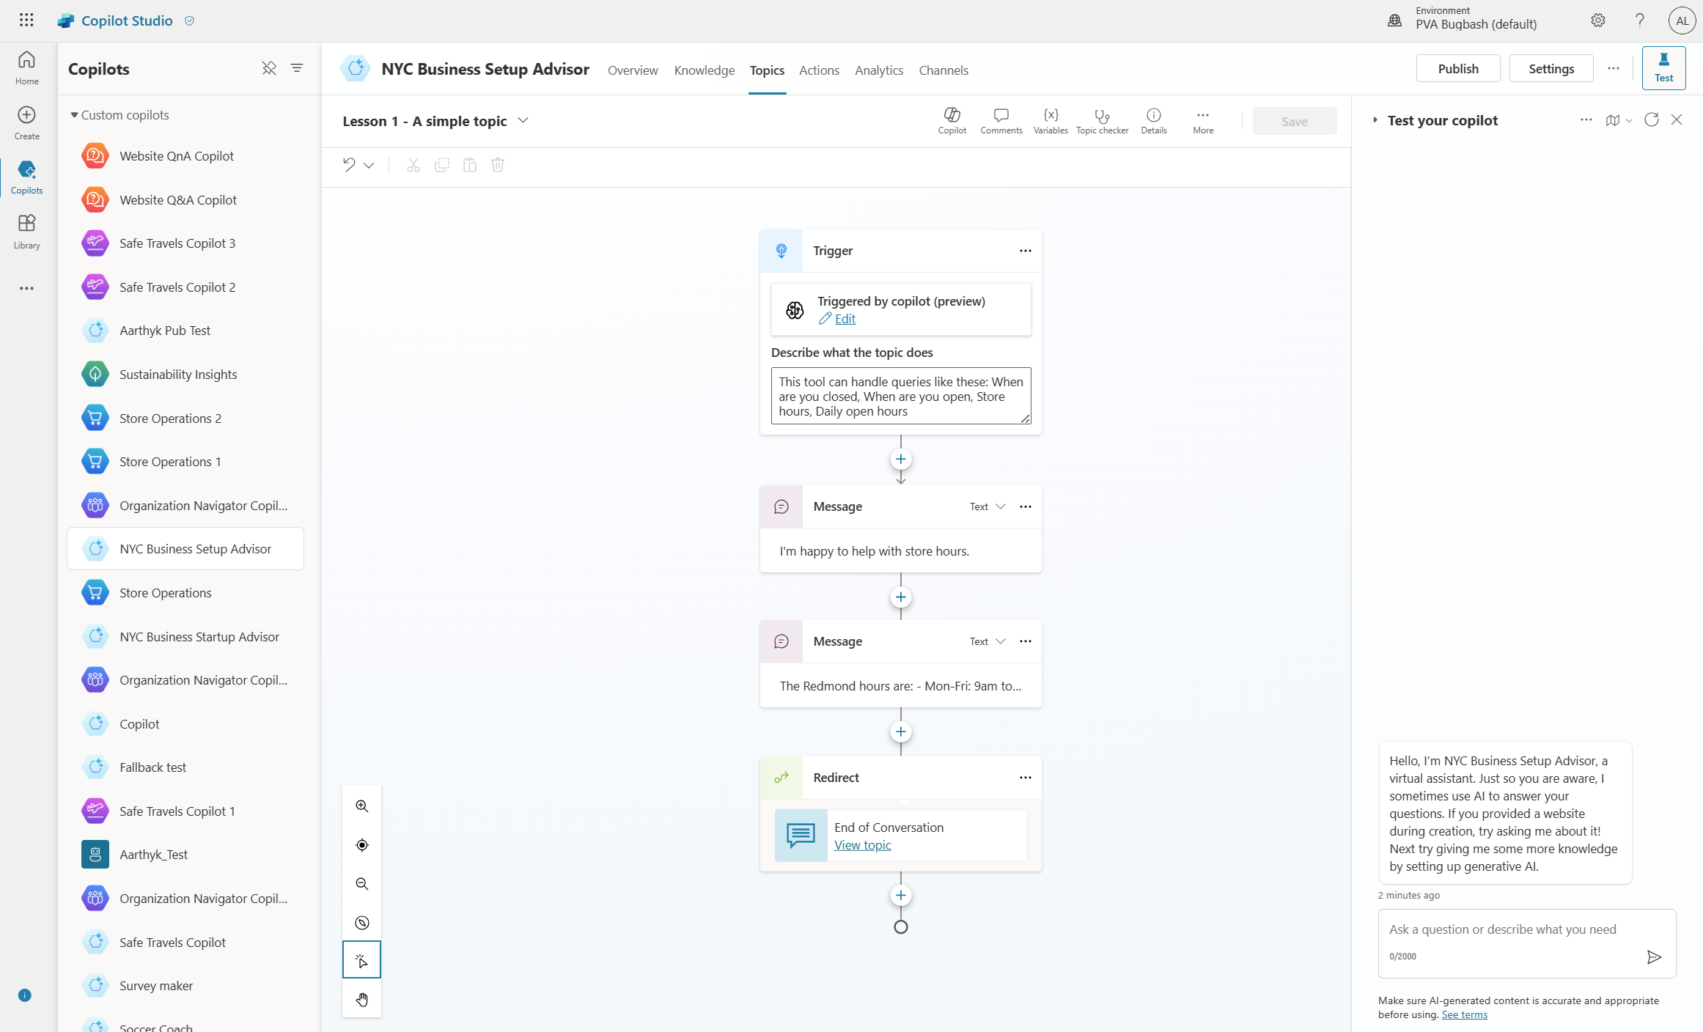
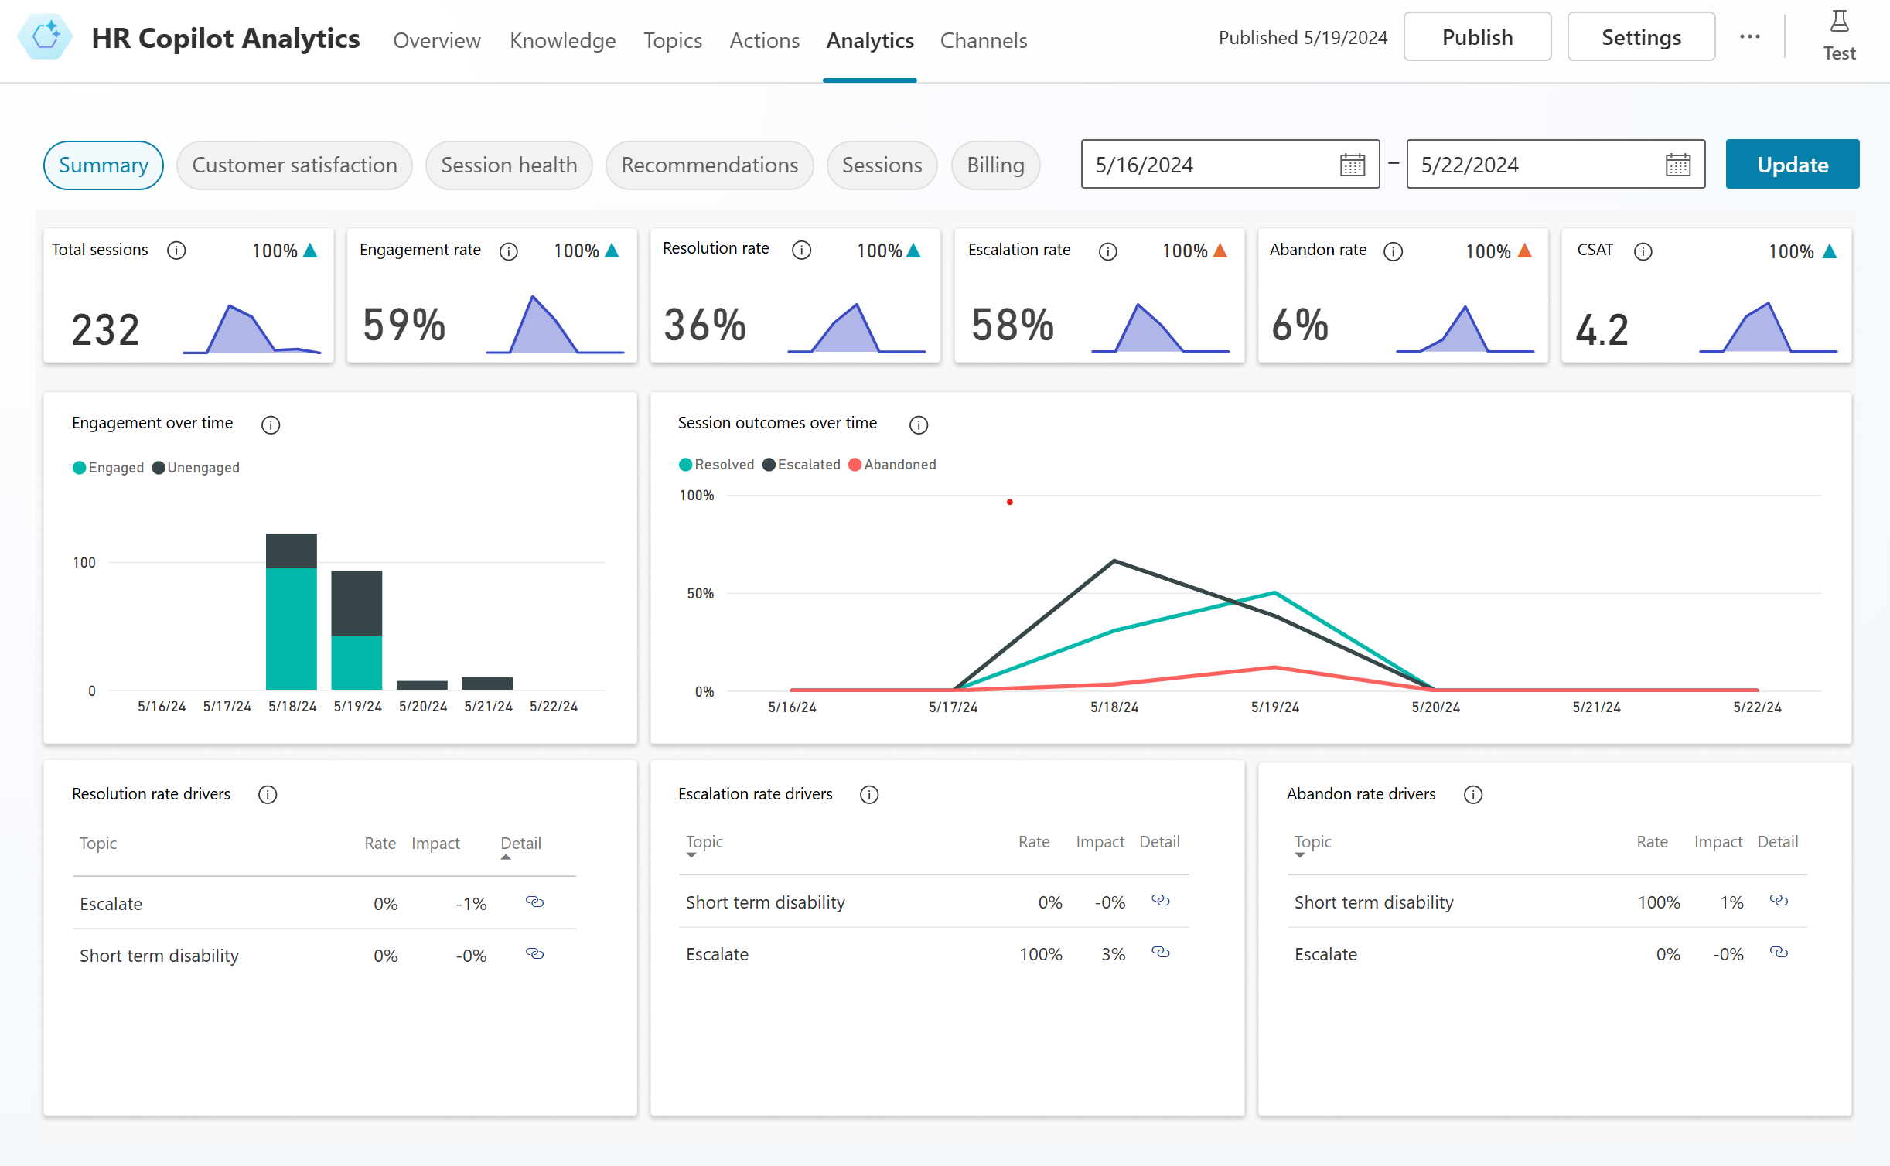
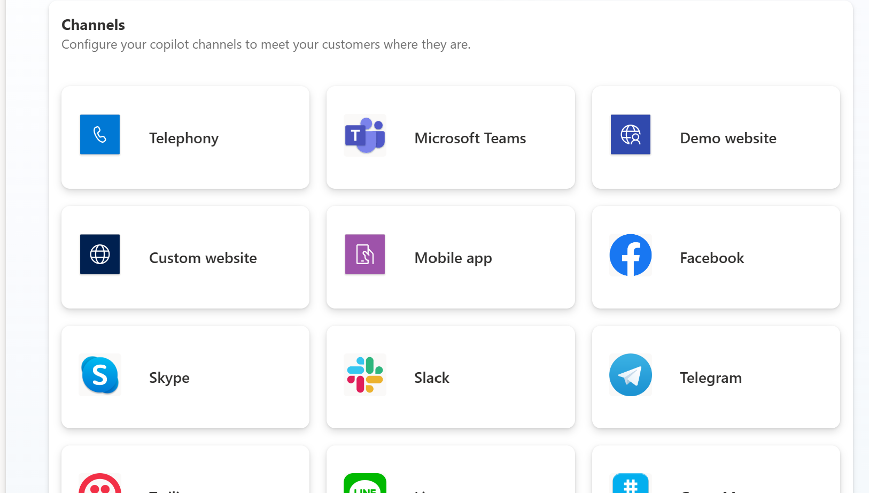
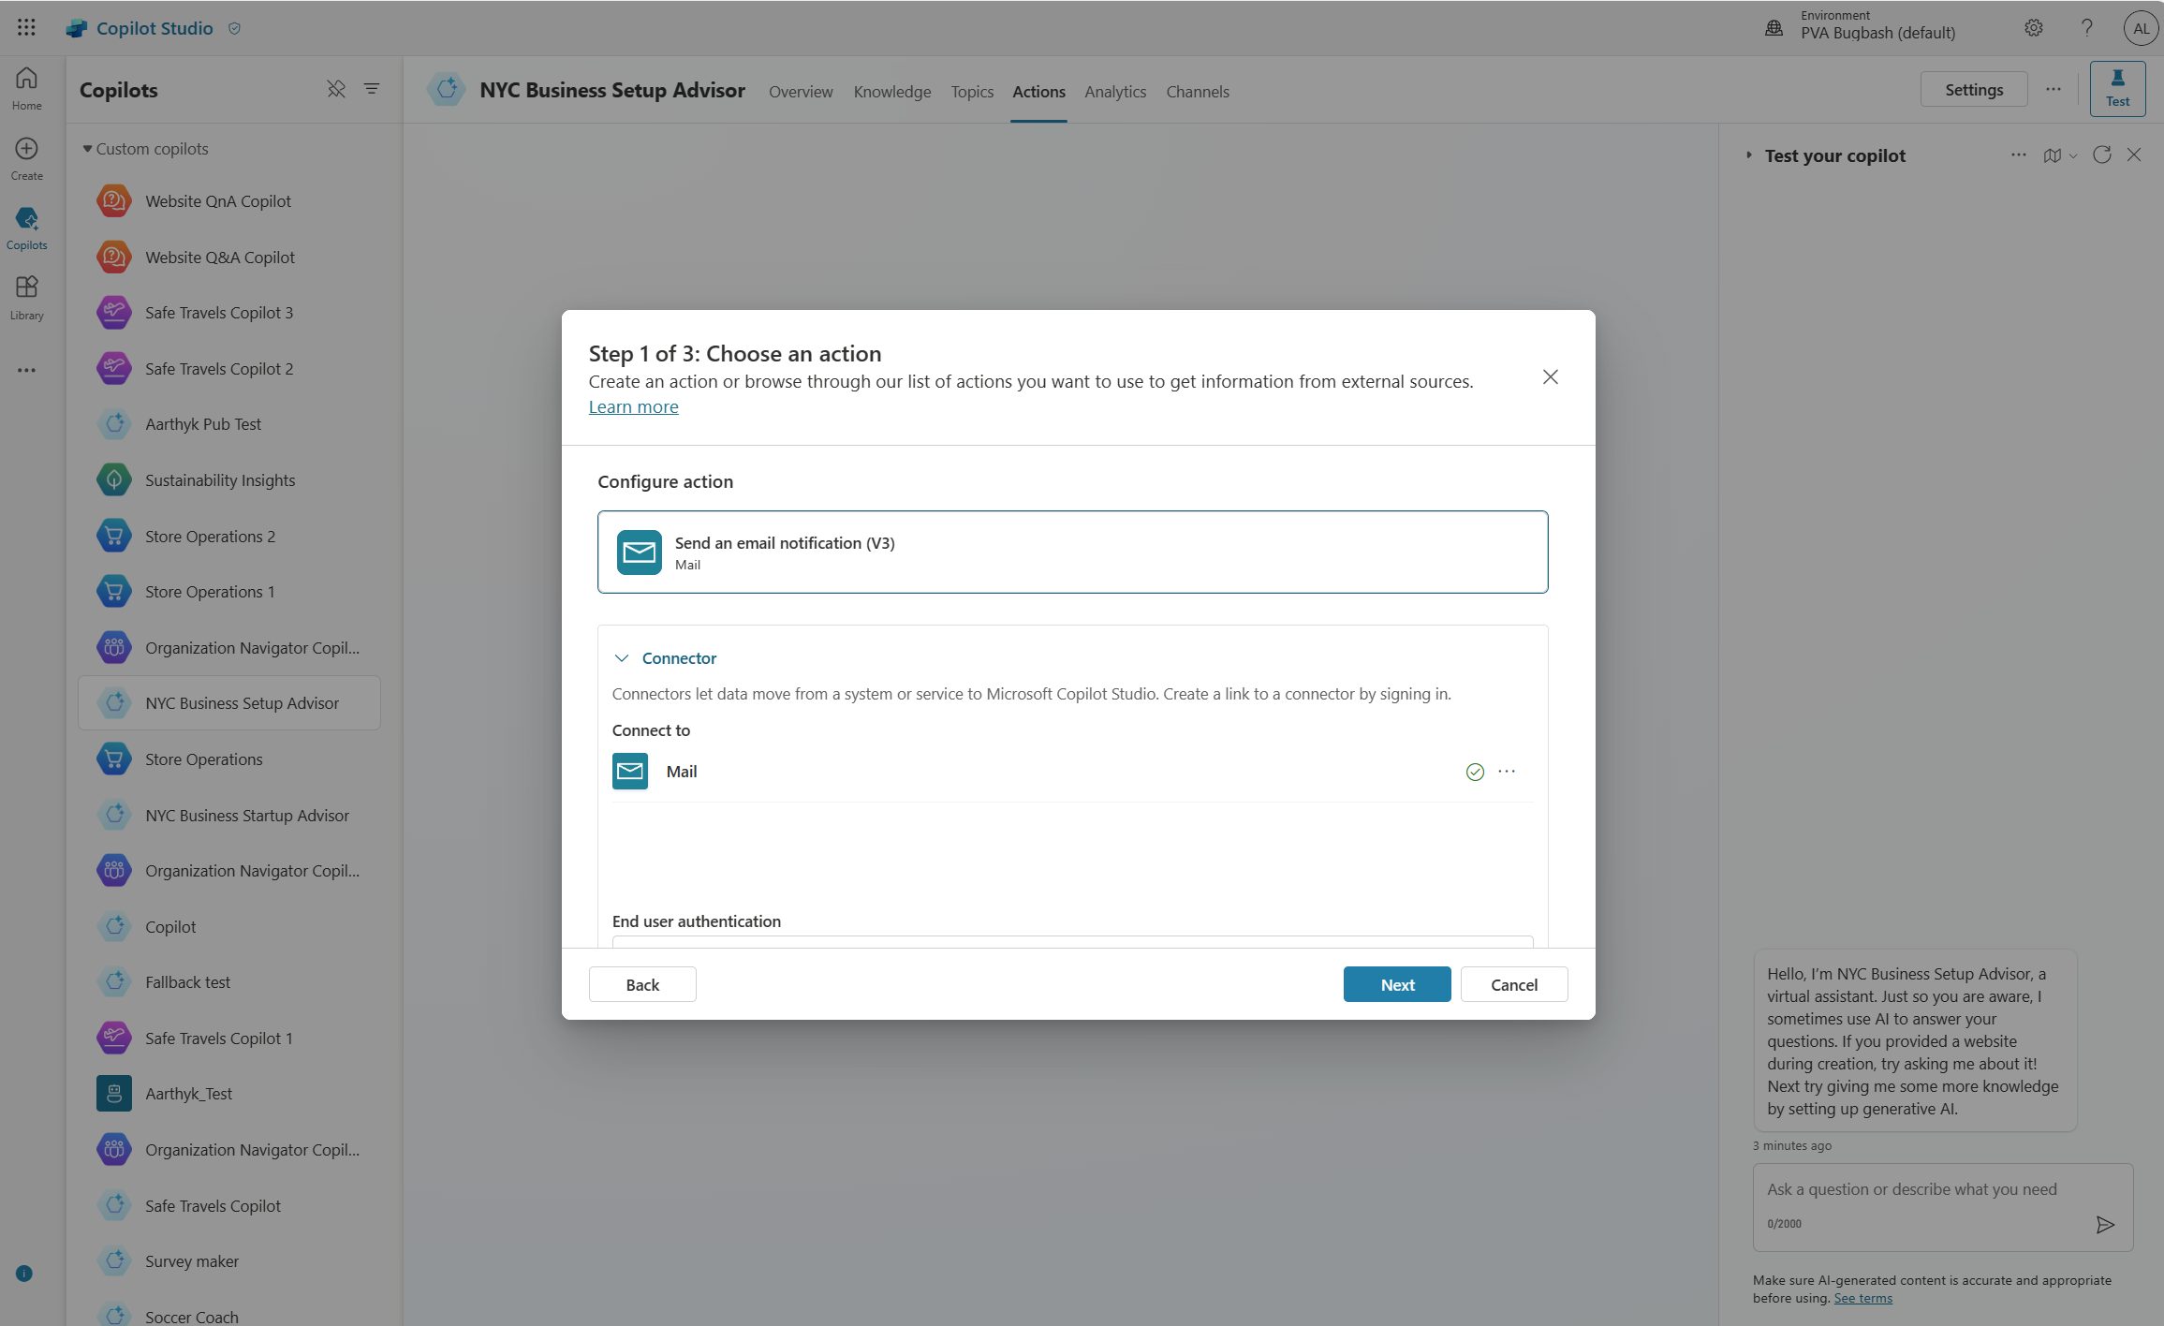
Create, manage, publish and extend agents Live in minutes - all from one tool and E2E SaaS service
Chat over knowledge with Gen AI Get enterprise specific answers over your files, websites, internal shares, Dataverse, third party systems and more
Integrate with AI Services Integrate with Azure AI Studio, Azure Cog Services, Bot Framework and various other Microsoft conversational services
Build & Publish
Create specific topics Supplement generative responses with specific, curated topics where you want tight control. Build them easily with the powerful graphical studio
Monitor and Improve with rich out-of-the-box insights and analytics
Copilot Studio
Build actions & Plugins Create actions, plugins, use 1000s of pre-built connectors or Power Automate to call your backends and APIs
Publish to multiple channels, and go live instantly on the SaaS service or choose to extend Copilot for Microsoft 365 with your custom capabilities
Analyze & Improve

Slide 16

Agents and Conversational AI
Microsoft 365
Conversational experiences for Microsoft 365
Biz Apps & Power Copilots
Conversational experiences for Dynamics 365 and Power Platform products
Other Microsoft Copilots
Agents
Custom agents for enterprises and third parties
Microsoft 365 Copilot
Agents
Service Copilot
Sales Copilot
Windows Copilot
Microsoft Security Copilot
Copilot for Power Platform
GitHub Copilot
…
Microsoft Copilot Studio Extend and customize 1st party copilots | Build custom Agents
Bot Framework / SDK
Bot Service Channels
Azure AI Studio
Azure AI Search
Power Platform Connectors
AI Builder

Slide 17

Why do we share this example?
Overview of the native capabilities of Copilot Studio to help you assess the features you’re planning to use in the project.
Copilot Studio Overview
Product capabilities
Post to multiple channels
IVR/
Telephony
Extend Microsoft 365 Copilot
World Class UX
Declarative
Rich Response
Intuitive
Ease of use
Copilot Assistance
Logic + Automation
Power Fx
Generative Answers + Actions
Power Automate
Bot Framework skills
Next-Gen AI
Prebuilt LLM
+ BOYM ⁽²⁰²⁵⁾
Generative AI
Proactive suggestions
Bring your own NLU model
Connected experience
Microsoft Teams
Dynamics 365 & 3rd-party CCaaS
1400+ Connectors
Azure AI Bot Service
Agent Lifecycle
Test pane
Collaboration
Solution management
ALM automation
Security + Governance
Trusted identity
Full visibility
Advanced RBAC
Granular DLP control
Microsoft’s end-to-end agent building platform

Slide 18
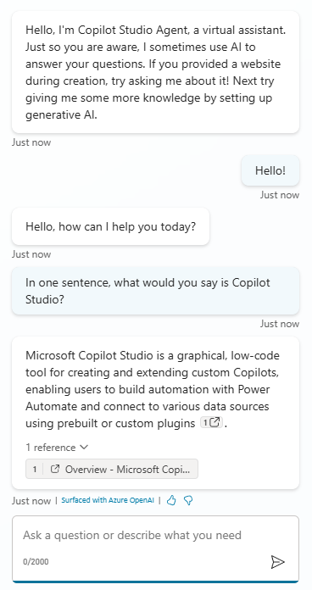
What does it take to create a conversational AI experience?
A runtime and channels to deploy the experience to (website, Teams, etc.)
Language understanding & orchestration capabilities
Understanding what the user says (intent) and how to react to it.
What key information (entity) to extract from user utterances?
Once published, an agent gets available to one or more channels, to meet the user where they are.
Analytics & transcripts data to measure efficiency
Dialog management capabilities
Technical telemetry, KPIs, and conversation transcripts are available to track performance and improve agents.
What should the conversation look like?
Should it be scripted like a funnel? Should it be open?
Security options to secure the endpoint and authenticate the end-users
Generative AI capabilities to create answers or take actions
Using AI, agents can search for information or use their general knowledge. They can also call APIs and connectors.
They can summarize answers.
Who can invoke the agent? Does the user need to be signed-in?
ALM
Ways to integrate with other systems
Deploying the agent and its related components across DEV, TEST, PROD.
End-to-end business processes often involve connecting with different systems and data sources.

Slide 19
Copilot Studio
Runtime (and channels)
Dialog management
Language understanding
Integrations
Generative actions
Generative answers
Triggers (for autonomous agents)
Security
Standard analytics
ALM
Conversation transcripts
Technical telemetry

Slide 20




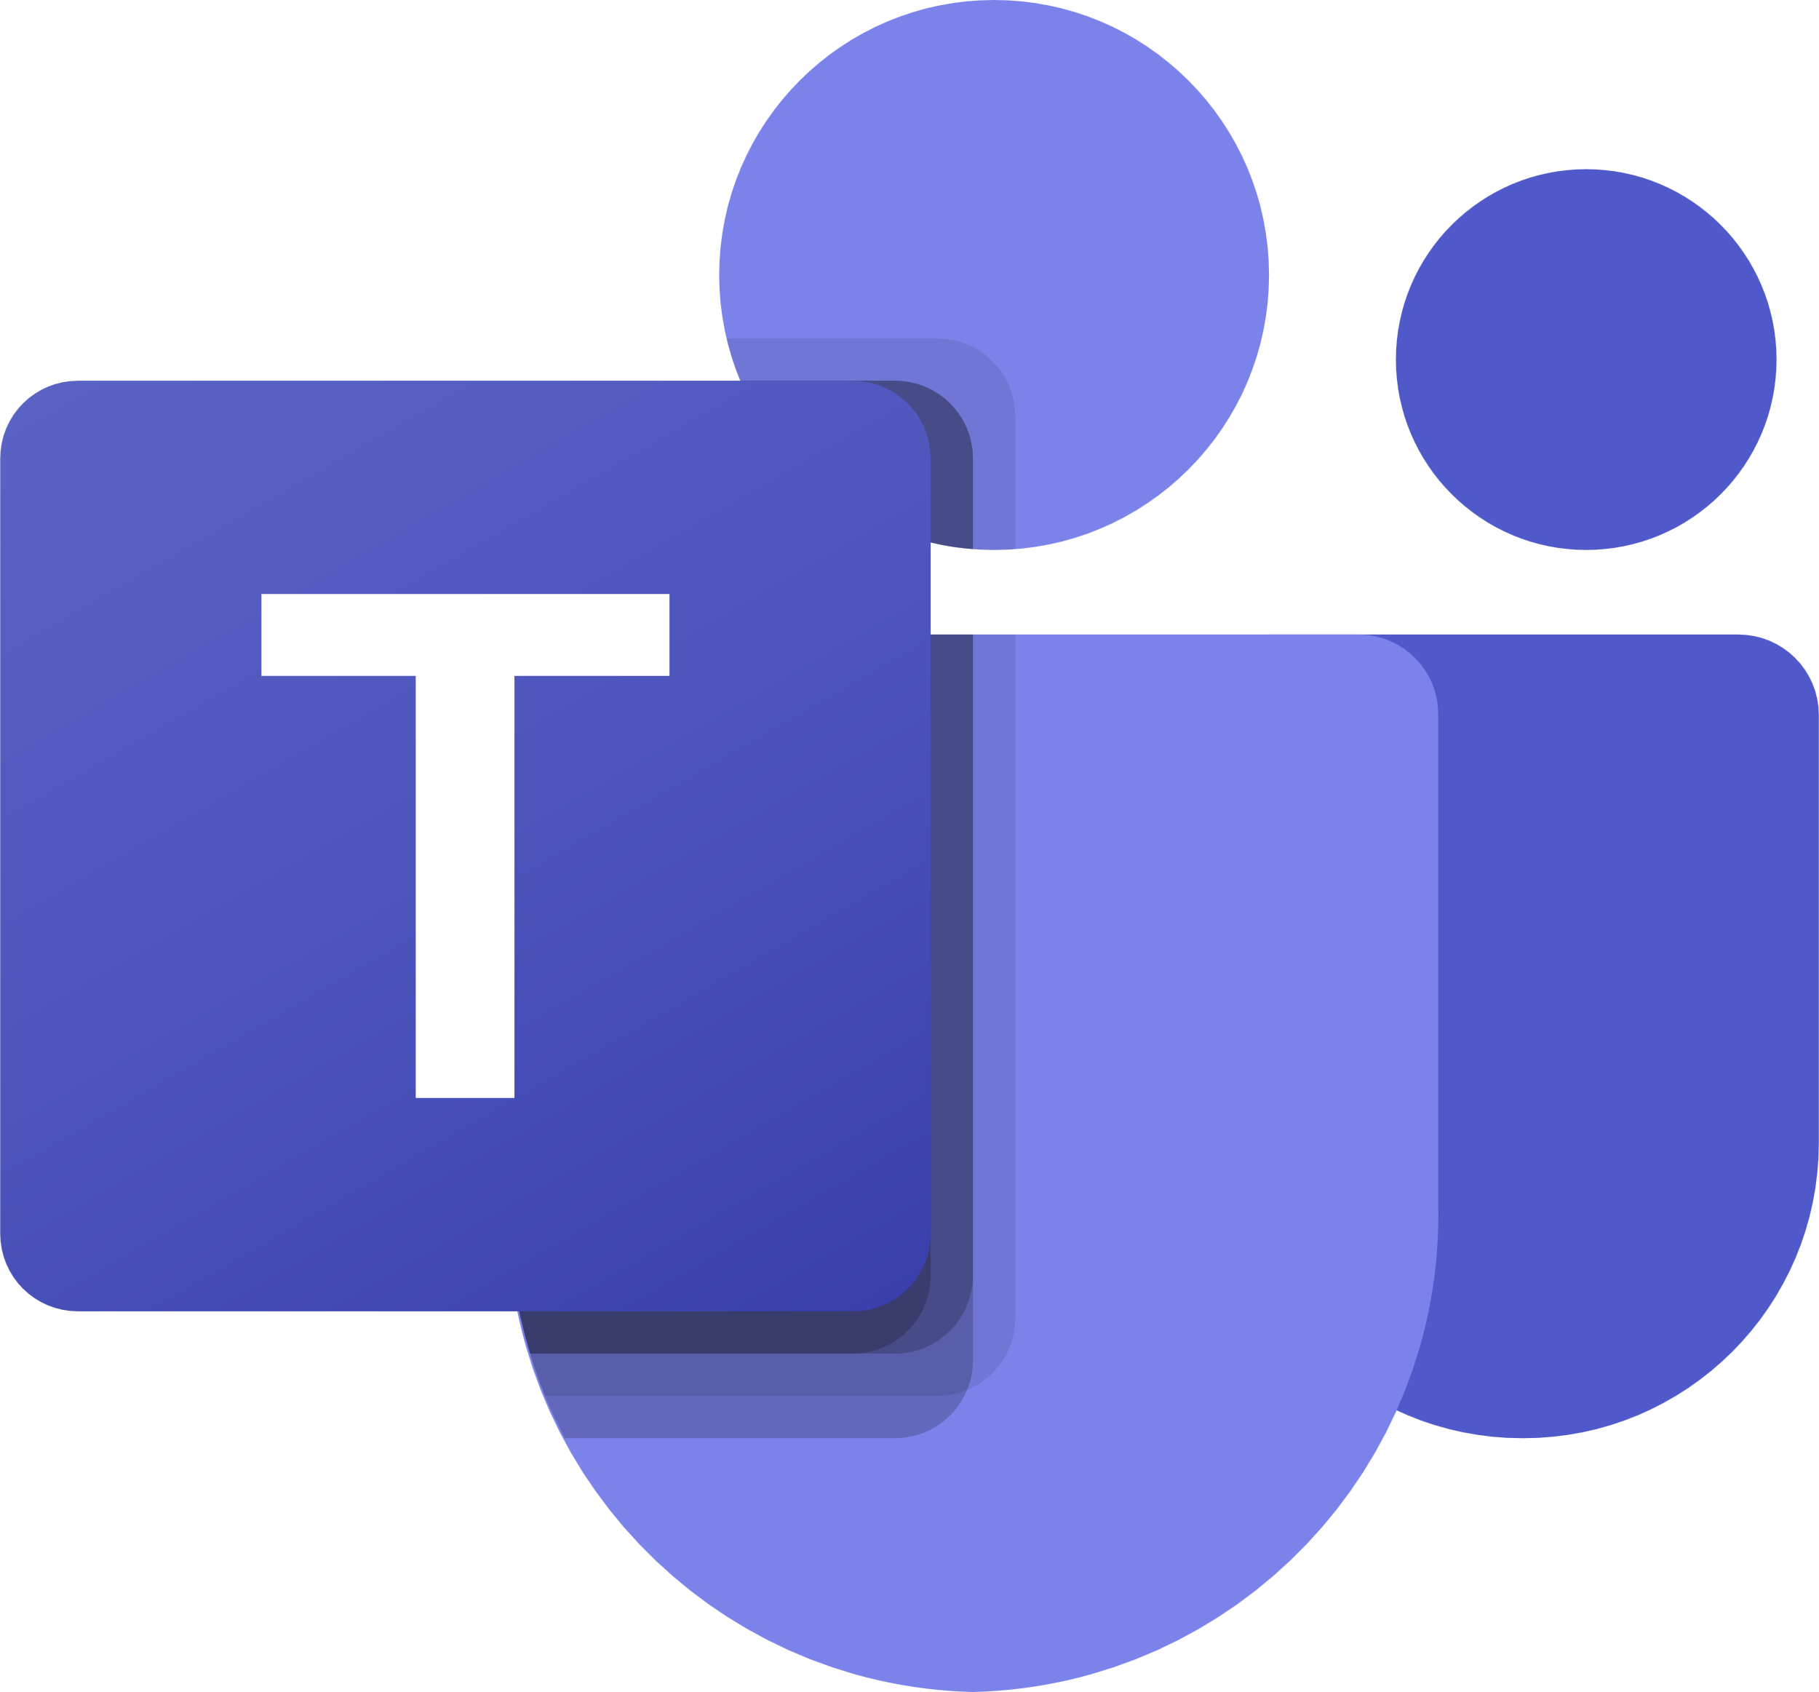





API-based clients
Copilot Studio Architecture
Azure AI Language
Copilot Studio standard clients
Conversational Language Understanding (CLU)
Standard Web Chat widget
Runtime
Dialog management
Language understanding
Power Apps chat control
Native channels
Topics
Nodes
Classic
Power Pages chat control
Microsoft 365 Graph
Direct Line (HTTP / WebSocket)
Actions
Power Fx
Built-in NLU
Enhanced search results
Custom clients
Direct-to-Engine (HTTP / SSE)
Voice
Multilingual
Bring your own NLU model
Bot Framework Web Chat
Microsoft Teams
Graph connectors
Generative orchestration
Custom apps & chat widgets
Facebook
Generative actions
WhatsApp ⁽²⁰²⁵⁾
AI-wrapper for integrations
Generative answers
Azure AI Search
Server-to-server
Slack ⁽²⁰²⁵⁾
Vectorized search indexes
Custom middleware
Inputs
Outputs
Query rewriting
Azure AI Bot Service channels (Telegram, WeChat, etc.)
Dynamics 365 Omnichannel
Microsoft 365 Copilot
Security
Knowledge search
Azure AI Foundry
3rd-party engagements hubs
Web channel security (secret)
Websites
Custom data
LLMs, SLMs, Fine-tuned models
Agent as a skill ^{(private preview)}
Files
SharePoint
Microsoft Teams
End-user authentication
DV Tables
Graph
Integrations
No authentication
Azure Monitor
Facebook Messenger
Federated Knowledge
HTTP requests
Native / Custom auth
Azure AI Search
Application Insights
WhatsApp ⁽²⁰²⁵⁾
Power Platform connectors
Power Platform DLP policies
Summarization
Slack ⁽²⁰²⁵⁾
Power Automate cloud flows
Authentication settings
Native
BYOM ⁽²⁰²⁵⁾
Azure Storage
AI Builder prompts
Enabled channels
Data lake
Dynamics 365 Contact Center (voice/text)
AI general knowledge
Bot Framework skills
Enabled knowledge sources
Microsoft 365 Copilot
Enabled connectors
Standard analytics
Azure Synapse Analytics
ALM
Microsoft Purview audit logs
Workspace
Azure AI Bot Service
Technical telemetry
Power Platform solutions
VNET / IP firewall ⁽²⁰²⁵⁾
Bot Framework bot
CI/CD (pipelines/ADO/GitHub)
Conversation transcripts
Microsoft Entra ID
Bot Framework skill
Triggers (autonomous agents)
App registration

Slide 21




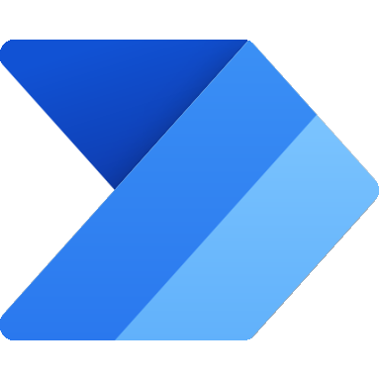
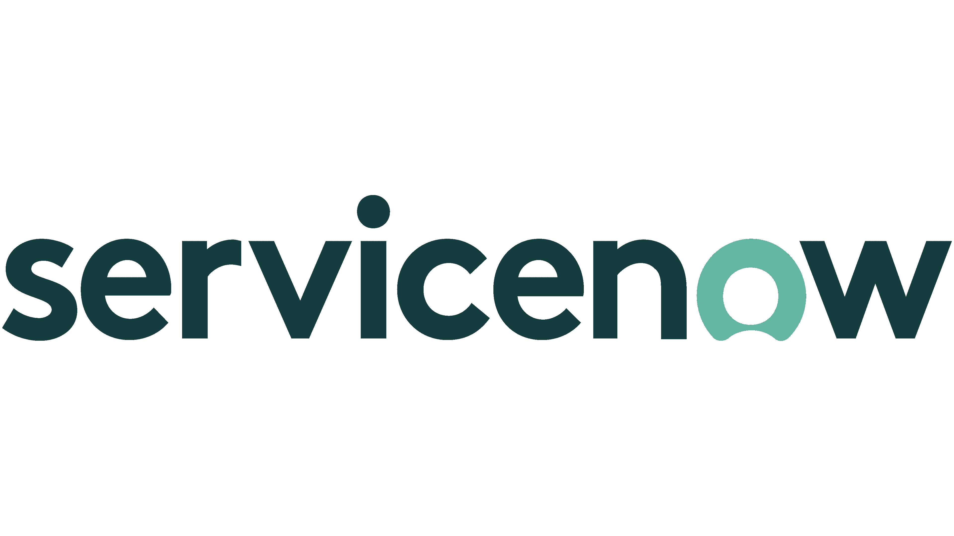
Why do we ask these questions?
To have the big picture of your agent project and its integration in a broader technical and functional landscape.
Information we’re looking for:
Architecture diagrams or blueprints
Functional and technical overview of the agent and its integration in the broader technical landscape (other Power Platform or Azure services, internal APIs, etc.)
Solution architecture
Provide an architecture diagram with the overview of the technical implementation
Example answer (you can delete this)
HR agent
41k employees
Handles HR, Finance, and IT questions.
Channels
Copilot Studio
Intranet
Generative answers
Teams
Power Automate
SharePoint
Websites
Multiple internal and external data sources

Slide 22
Why do we ask these questions?
Understanding target volumes helps validate the target architecture and scale.
When integrating with external systems, for example through Power Automate or HTTP requests, it’s important to validate that every part can handle the load.
Target volumes also help validate the licensing aspects of the agent and the potential impact on Dataverse storage for the conversation transcripts.
Useful resources:
Rate limits for agents
Pricing plans
Microsoft Power Platform Licensing Guide
Conversation volumes
What are the expected volumes of chat messages or conversations?
Monthly target volume of : Total messages Generative actions Generative answers Power Platform requests (through connectors or cloud flows)
Expected seasonality impact
Expected maximum peak of concurrent conversations
Example answer (you can delete this)
200,000 chat sessions per month (with an average of 8 messages per session), including 100,000 generative answers, 50,000 generative actions, and 1,000,000 Power Platform requests.
Example answer (you can delete this)
800,000 monthly chat sessions in December and January.
Example answer (you can delete this)
Maximum of 5,000 concurrent chats when sales season begins.

Slide 23
Why do we ask these questions?
While there are no guaranteed service level agreements (SLAs) for Copilot Studio response times – mainly because they depend on complexity, integration patterns, etc. – it’s still important to understand performance expectations for the agent response times to make sure the agent design optimizes for performance.
Useful resources:
Capture telemetry with Application Insights
Performance
Detail the expected agent response times
First chat load time and first message expectation
Expected maximum latency for the agent to answer user queries
Approach for handling long-running actions (e.g., waiting for an external system to return data)
Example answer (you can delete this)
5 seconds for the web chat control to load and for the initial messages to be displayed to the user.
Example answer (you can delete this)
3 seconds after a user provides an input.
Example answer (you can delete this)
A specific message is displayed to the user asking them to wait while the cloud flow runs and returns data. Typing indicator shows that the agent is doing something.

Slide 24
Why do we ask these questions?
To understand the challenges that have already been identified in the architecture that could get in the way of the agent success and for which it’s important to define mitigation plans.
Identified technical challenges
Please share the list of technical challenges or roadblocks you have already identified
Challenge #1
Challenge #2
Challenge #3
Example answer (you can delete this)
Connecting to on-premises resources that are not exposed to the public internet.
Example answer (you can delete this)
Deploying to a WhatsApp channel.
Example answer (you can delete this)
Allowing agent end-users to download the conversation transcript at the end of the chat session.

Slide 25
Language understanding
Natural Language Understanding
Intent recognition and slot filling
Azure CLU integration
Topic structure
Handling unrecognized intents
Localization & languages
Miscellaneous

Slide 26



Natural Language Understanding
I want to book a flight to Paris next week.
I want to book a flight
to
Paris
next week
Utterance
Intent
Entity
Entity
Customer has the intent to ‘book a flight’
The query already has a ‘Destination’, Paris, and a ‘Travel Date’, next week.
Great choice!
To ensure we get it right, could you confirm the departure city and your travel class preference? I’ll take care of the rest!
Given this intent, entities, and the context, what would be the best fitting answer?

Slide 27



Why do we share this?
NLU (Natural Language Understanding) is a subfield of NLP (Natural Language Processing) that specializes in the machine's ability to comprehend and make sense of human language in a valuable way, focusing on understanding context, sentiment, and intent.
In Copilot Studio, topic or action triggering can be done in different ways: customers can choose to override the standard NLU model with Azure CLU (Conversational Language Understanding) – the modern equivalent of LUIS – or can be fully replaced with dynamic chaining, an LLM-based one.
Azure CLU is a feature of Azure AI Language.
Useful resources:
Trigger phrases best practices
Slot filling best practices
Copilot Studio supported languages
Azure CLU supported languages
Azure CLU limits
Azure CLU pricing
How to use CLU as your NLU (video)
Generative orchestration
Natural Language Understanding
Choosing the right option for intent recognition and entity extraction
Built-in NLU model
Custom Azure CLU model
Generative orchestration
Default, out-of-the-box, model that comes pre-trained, with many predefined entity types.
Configuration is done by adding trigger phrases and custom entities (either closed lists with values and synonyms, or regular expressions).
Supports additional languages, with native models.
Allows to further customize the intent triggering model for better intent recognition or to address specific industry requirements.
Advanced entity extraction (e.g., same type, or silent extraction).
Entity extraction can also leverage Copilot Studio standard NLU.
Uses a large language model.
Can handle complex utterances with multiple intents, chain topics/actions, and knowledge.
Automatically generate questions for missing inputs.
Allows corrections when running.
When complete, a unified answer gets generated based on the outputs of all topics, actions, knowledge.
Single intent recognition per query.
Cannot be extended.
Slot-filling multiple entities of the same type in the same query requires disambiguation for each (e.g., from and to cities)
Single intent recognition per query.
Configuration is done in Azure and involves additional costs.
Has its own service limits that need to be evaluated.
Azure CLU intents and Copilot Studio topics must be carefully kept in sync.
25 messages per topic or action chained in the orchestration.
Limit of 127 topics and actions allowed for triggering for the orchestration.

Slide 28
Classic orchestration
Topic selection
Topic
Topic is executed as authored by maker, including questions, messages and calls to external data / actions.
Topic
User utterance
Topic
Response
Topic
matched
Topic
Topic
No topic matched
Fallback - Search over knowledge
Search available knowledge sources and summarize an answer using generative AI if an answer is found.
Response
No answer found
Fallback System Topic
“Sorry, I didn’t understand that”

Slide 29
Generative orchestration
Plan generation
Topic
Topic
One or more actions / topics / knowledge matched
A plan is generated using actions / knowledge / topics
Action
User utterance
Topic
Slot filling
Unified Response
A message is generated to answer a user’s question using the outputs from all actions / knowledge / topics in the plan.
Action
Execution
Action
Response
Knowledge
Knowledge
Knowledge
Search
Summarize
Fallback System Topic
“Sorry, I didn’t understand that”
Citations

Slide 30
Why do we ask these questions?
Trigger phrases:
Trigger phrases train your agent's natural language understanding (NLU) model.
It’s important to appropriately configure them to make sure that the right topic triggers for the user utterances.
When an agent is uncertain what topic to trigger, it can suggest up to 3 potential topic candidates (Multiple Topics Matched topic) or go to Fallback if no topic is identified.
Entity extraction and slot filling:
Slot filling relates to the use of entities that let an agent acquire and use information more easily by identifying and extracting them from the user query.
For example, when a user asks: “I’d like to order 3 large blue t-shirts”, the Natural Language Understanding (NLU) can immediately understand:
Topic is Order.
Quantity is 3.
Color is Blue.
Size is Large.
Item Type is T-Shirt.
And the related questions be skipped.
Useful resources:
Trigger phrases best practices
Slot filling best practices
Copilot Studio Kit for testing.
Intent recognition and slot filling
Leveraging native capabilities for better intent recognition and efficient conversations
How are you planning to define the topics trigger phrases / descriptions?
What is your expected use of entities (prebuilt, closed list, regular expressions).
Do you plan to test topic triggering with test utterances?
Example answer (you can delete this)
From an existing FAQ base and from agent chat transcripts.
Example answer (you can delete this)
Regular expressions to identify an order ID, prebuilt entity for email, and closed list for operation type and synonyms for each.
Example answer (you can delete this)
Yes, bulk testing to make sure the relevant topics are triggered based on a set of test user utterances.

Slide 31
Why do we ask these questions?
You can integrate a Conversational Language Understanding (CLU) model with a Copilot Studio agent.
Azure CLU intents must be mapped with Copilot Studio topics.
Copilot Studio prebuilt entities can be used in conjunctions with Azure CLU entities.
Using Azure CLU requires separate Azure resources and involves separate costs.
Useful resources:
Azure CLU integration overview
Azure CLU best practices
Azure CLU limits
Azure CLU pricing
Azure CLU integration
Overriding the standard NLU model with Azure Conversational Language Understanding
Do you plan to use Azure CLU? If yes, why? What benefits are you expecting?
Are you also doing custom entity extractions with Azure CLU? Why?
How are you making sure the related Azure CLU service quotas and limits match the use of the agent?
Example answer (you can delete this)
Using Azure CLU to achieve better intent recognition scores in non-English languages, industry specific dictionaries and complex entity extraction.
Example answer (you can delete this)
To do silent or lucky slot filling without having to ask questions and to handle unsupported scenarios in Copilot Studio such as source and destination city in the same phrase.
Example answer (you can delete this)
Azure CLU is setup using the S tier. Less than 1,000 calls requiring intent recognition are expected per minute.

Slide 32







Why do we share this example?
This example showcases the use of a disambiguation topic. It’s very useful when it’s hard or impossible to be certain of triggering the right topic if the user doesn’t provide enough details in their query. This also prevents triggering a multiple topics matched topic that sometime confuse users.
In this example, trigger phrases are associated to two main topics, that then break down their logic into multiple sub-topics that are called with redirect actions.
Some topics can be called by multiple other topics: that's typically the case with the End Of Conversation topic.
Thanks to slot filling and entity extraction, if a user says "I need to unblock my credit card", the Card topic will get triggered and both Debit/Credit and Block/Unblock questions will be skipped, as the Card Type and Operation Type will be deduced from the trigger phrase. That way, the appropriate Credit Card child topic will automatically be called, without the user providing any additional input or even noticing they went through the disambiguation topic.
Useful resources:
Topics best practices
Topic structure example for disambiguation
Mixing topics triggered by trigger phrases and redirected topics
Natural Language Understanding Trigger phrases | “Trigger Phrases” Topics Triggered from trigger phrases or redirects | Reusable, Bite-Size, Topics Explicitly called by topics
Topic: Card
Topic: Debit Card
Issue with my card
Block card
I need to block my credit card
Need help blocking debit card
Unblock card
Need to unblock credit card
How to unblock my debit card
Question: Debit/Credit
…
Question: Block/Unblock
Condition
Topic: Credit Card
Debit
Credit
…
End of Conversation
Topic: End of Conversation
Topic: Location
…
Find my nearest bank
Check branch location
Find a bank
Find me your nearest location
Banks near me
Question: Location
Location
Topic: Location Check
Message
…
End of Conversation

Slide 33
Why do we ask these questions?
Topics are discrete conversation paths that, when used together, allow for users to have a conversation with a agent that feels natural and flows appropriately.
While there's no one size fits all, given how topics can be triggered, it's a good practice to distinguish between:
Topics that will trigger based on user utterances. These can almost be seen as your entry points topics. If you have trigger phrases that overlap multiple topics, consider having a catch-all topic and then redirect to other topics after clarifying questions. With entity extraction and slot filling, clarifying questions can be skipped if already answered.
Topics that will trigger when called from a redirect action, activity or event. These can be called by multiple topics and can have input and output variables. They're ideally reusable, bite-size, topics.
A topic can also be both, triggered through intent recognition or by an explicit redirect.
Conversational boosting and fallback: topics that trigger when no matching topic is triggered based on a user query.
Useful resources:
Topics best practices
Topic structure
Creating and designing efficient topics
What is your approach to designing topics?
Do you plan to use disambiguation topics?
How are you avoiding duplicating topic content multiple times?
Example answer (you can delete this)
A few custom topics for key scenarios with relevant trigger phrases and redirects, with a parent-child topic structure. Unrecognized intents will trigger generative answers and fallback.
Example answer (you can delete this)
Yes, for user account operations with clarifying questions on the operation (e.g. create, unlock, suspend, etc.) and system (e.g. SAP, ServiceNow, Microsoft, etc.)
Example answer (you can delete this)
Whenever a dialog path needs to be repeated, creating reusable topics that can be called by a parent topic before resuming the parent topic conversation logic once the child topic is complete.

Slide 34
Why do we ask these questions?
The Fallback topic gets triggered when Copilot Studio doesn't understand a user utterance and doesn’t have sufficient confidence to trigger any of the existing topics.
If Generative Answers are enabled on the agent, the Conversational Boosting topic also triggers on the unknown intent event and triggers before the Fallback one.
There are many ways to handle unrecognized intents: using Generative Answers to look for the answer on various data sources and/or using the Fallback topic to integrate with other systems. For example, question answering in Azure Cognitive Service for Language allows you to offload large volumes of question-and-answer pairs. It also has a chitchat model to handle random questions to the agent.
While it’s important to leverage the Conversational Boosting and Fallback capabilities, it’s also important to make sure that the core scenarios and topics of your agents are property handled through custom topics and their outcomes defined (resolved, etc.).
Useful resources:
Generative Answers
Using the Fallback topic
Handling unrecognized intents
Answering for unplanned user queries
How are you planning to manage unrecognized intents?
Are you integrating with an external system as part of fallback? If yes, how?
What is the expected % of conversations hitting fallback?
Example answer (you can delete this)
First by going to the Conversational Boosting topic to look for the answer in knowledge resources (SharePoint and public websites) and if no result to a fallback ChatGPT-like experience.
Example answer (you can delete this)
An o1 model is called through a custom connector.
Example answer (you can delete this)
25% initially, and these are regularly reviewed to enrich existing topics or create new ones.

Slide 35
Why do we ask these questions?
There are multiple ways to address agent localizations. Understanding your requirements will help make better architecture recommendations.
The main approaches are:
One agent per language.
One agent for multiple languages, with translations provided as part of the agent configuration. Translations need to be updated each time the agent is updated or when new content is added.
One agent for multiple languages, with translations provided real-time, at runtime, through a relay agent sitting between the user and the agent. This allows deploying more languages rapidly, but it also adds a dependency on a relay agent and a real-time translation layer (e.g., Azure Service Copilot and Azure Cognitive Services Translator).
Useful resources:
Supported languages
Azure CLU integration
Real-time multilingual agent sample
Configure multilingual chatbots
How to make multilingual copilots (video)
Make generative answers multilingual (video)
Localization & languages
What languages should your agent speak?
What languages and markets should your agent support?
Do you plan for a single multi-languages agent, or for one agent per language?
Should the translations be set during configuration or real-time (i.e., provided at runtime)?
Example answer (you can delete this)
Primarily US English (70% of end-users), Spanish (20%), French, Portuguese (Brazilian) and Dutch (Belgium Flemish).
Example answer (you can delete this)
A single agent enabled for multiple languages, with condition logic based on the end-user language so that some topics are only available for specific regions.
Example answer (you can delete this)
Not yet, but this could be considered to deploy to more markets more rapidly.

Slide 36
Why do we ask these questions?
Sessions can be configured to last for more than the default 30-minute by using the inactivity trigger.
Useful resources:
Inactivity trigger
Conversation Design Institute
Miscellaneous
Miscellaneous conversation design questions and requestions
Do you have specific requirements on session timeout? (i.e., how long an agent session can last)
Do you have other requirements or questions on conversation design?
Example answer (you can delete this)
We need chat sessions to last up to 7 days on the Teams channel.
Example answer (you can delete this)
No, the agent business subject matter experts in the project all trained and certified with Conversation Designer Certification from the Conversation Design Institute.

Slide 37
AI capabilities
Generative AI is changing conversational AI
Generative answers
Generative actions and dynamic chaining
Generative builder (Copilot)
Other AI requirements

Slide 38



Why do we share this example?
Before generative AI, companies used to create every topic their bots needed by hand, and they could only create so many, perhaps a few hundreds – and then they had a large cliff of unsupported things a user couldn’t talk about.
These then would create user frustration with the bot saying "sorry I didn't understand you“, or large costs by having it just to dump the user to a human agent.
Generative AI is changing conversational AI
Before generative AI
Manually authored topics
Anticipate and build a manual topic for each possible user question
Then keep these topics up to date as your content changes
BUSINESS CRITICALITY
Missed opportunity
Time spent hand-building topics
Conversations missed or escalated
TOPICS BUILT

Slide 39

Why do we share this example?
Now, with Generative AI, companies are increasingly only building a few, business critical topics where they want tight control over the dialog.
And for everything else, they're just pointing to knowledge sources and allowing the bots to talk over those corpuses.
That means vastly increased support coverage for anything a user could ask, and far less topics that need to be handled by human agents.
But it also means that maintaining topics is far less onerous - as the information changes, the agent answers change automatically.
There are no dialogs to continually update and keep relevant. So, this dramatically reduces costs.
Generative AI is changing conversational AI
After generative AI
Manually authored topics
Manually author business-critical topics quickly with Copilot Studio
BUSINESS CRITICALITY
Expose your knowledge sources and APIs and generative AI handles the rest
Custom-built topics + help from generative builder
Vast coverage of the long tail, and as content changes, agent answers change as well
Topics handled by Generative Answers and Actions
TOPICS BUILT

Slide 40













Knowledge sources & Generative AI
Public data
Websites must be indexed by Bing.
Bing cannot be restricted to a region.
Confirming website ownership leads to better results.
Public Website
Max 2 subpages depth (/en/help/), no direct pages.
One configuration ID, but it can be set using a formula.
Azure costs covered by Microsoft.
Up to 400 URLs, custom ranking options.
Max 2 subpages depth (/en/help/), supports direct pages.
Bing Custom Search
1
Query rewriting
SharePoint
Optimizing the user question for search
Requires the user to be authenticated with Entra ID to make delegated calls.
Matching files (max 7 MB) are retrieved to get detailed snippets to summarize.
Security trimming: returned results only include content the user has read access to.
The premium 'Enhanced Search Results' features leverages Tenant Microsoft Graph grounding for messages, increasing results quality and max file size (200 MB).
Last 10 turns are leveraged for contextualization
Internal only
Uploaded files
2
Content retrieval
Files (512 MB max) are stored in Dataverse file storage, with a maximum of 500 files per agent.
Files are indexed in Dataverse Search and benefit for image/table recognition in PDFs.
By default, citations don’t contain a link to the file, but this can be done with customizations.
Querying each source
Top 3 results per source
Dataverse tables
Dataverse tables (max 15) can be configured with synonyms and a glossary to improve search.
Natural language queries are transformed in analytical queries over structured data.
3
Summarization
Graph Connectors
Answer summarization from retrieved content
Requires the user to be authenticated with Entra ID to make delegated calls.
Connect to additional enterprise knowledge sources that are indexed in the Microsoft Graph index, like ServiceNow KB, Confluence, custom enterprise website data, etc.
The premium 'Enhanced Search Results' feature leverages Tenant Microsoft Graph grounding.
Citation generation
Answer personalization with custom instructions
Real-time Connectors
Copilot connectors retrieve structured data from Salesforce, ServiceNow, Zendesk, Azure SQL.
Connections to the target systems must be created by the logged-in user.
Validation at each step
Azure AI Search
Returns results from a linked vectorized Azure AI Search index.
Connection isn’t delegated: no security trimming, no authentication requirement for the user.
Moderation of harmful, malicious, uncompliant, or copyrighted answers
Requires a prior step to query the source (e.g., with cloud flows, connectors, or HTTP requests).
Results are passed as inputs to the generative answers to summarize an answer for the query.
Input data needs to be in table format, with 3 properties: Content (typically snippets of relevant content) , ContentLocation (optional, typically a URL) and Title (optional).
Grounding validation and hallucination removal
Custom data

Slide 41




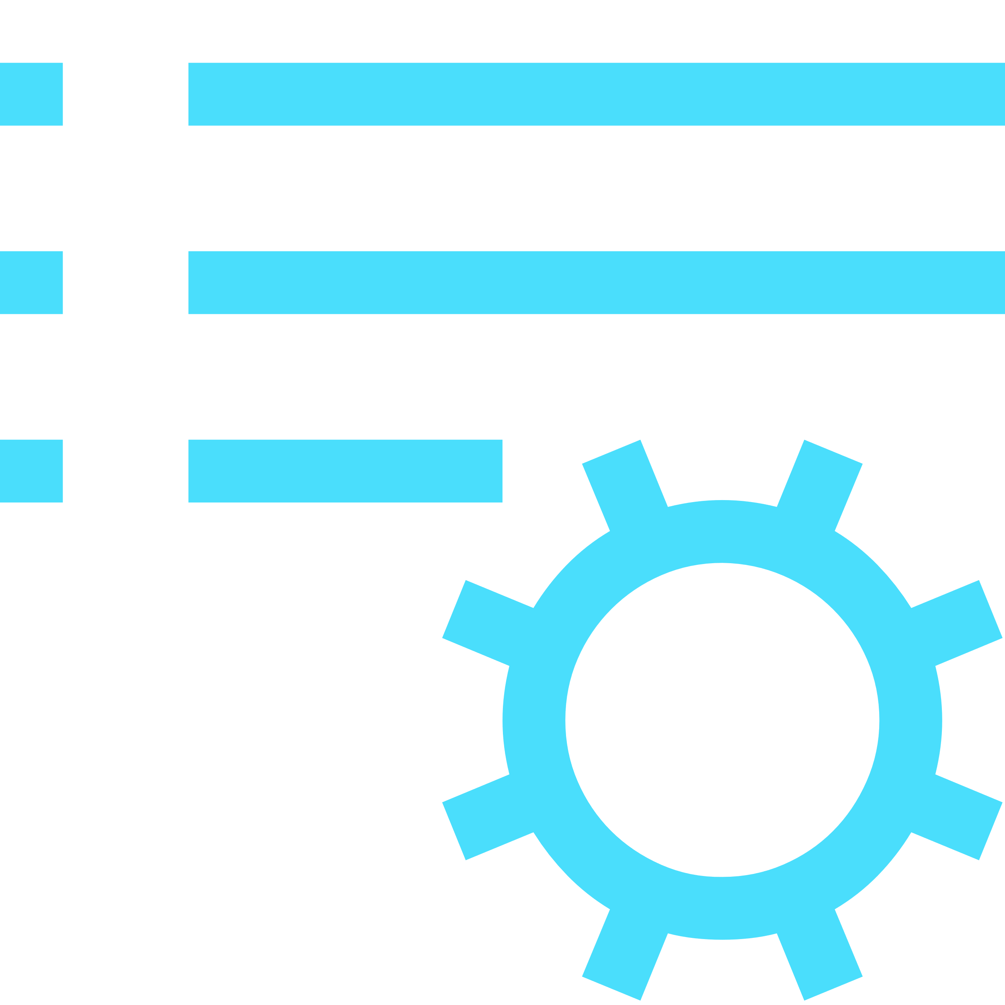





Generative AI security and compliance considerations
The large language models (LLM) Copilot Studio depends upon are the foundation models trained by OpenAI.
Generative answers uses GPT-4o, but as new models outperform previous ones, they can be updated.
Models are hosted on internal Azure AI Foundry services, honoring the Microsoft Services Trust boundary.
Models are accessed and used following Microsoft Responsible AI principles and policies.
Custom instructions can be added to generative answers to influence format and filters.
Data storage and processing for Copilot Studio generative AI capabilities may result in data movement across regional boundaries. When local data storage and processing aren’t available in the region, environment settings are available to disable features requiring Azure LLMs or Bing Search, preventing data movement.
Copilot Studio does not collect, nor provide any customer data, for use in the training of LLMs.
For operations purposes only, conversations are stored temporarily in a service-operated and secured store so that authorized Microsoft employees via Secure Access Workstations (SAWs) with Just-In-Time (JIT) access requests may respond to support requests. Access can be controlled through Customer Lockbox.
Generative AI capabilities log additional troubleshooting data, but only when the thumbs up or down reactions are used by the agent author in the Copilot Studio test pane.
Given the existing control layers and to avoid further logging of customer data, Azure AI abuse monitoring is disabled for Copilot Studio generative AI features.

Slide 42
Why do we share this example?
This shows how generated responses are plugged into a dialog manager (Copilot Studio) to ensure that you remain in control of the user experience while allowing for authored experiences that are key functions of your agent, scripted responses that are key for managing the answers you want scripted (such as marketing-controlled responses) work in conjunction with generated responses allowing the enterprise to remain in full control of the experience.
This allows for an end-to-end enterprise conversational platform to build effective and managed experiences that delight customers, while reducing the overhead and cost of maintaining fully scripted experiences of the past.
Topic examples:
Authored Topics “How many miles do I have in my account?”
FAQ / Scripted Responses “Why are all flights currently grounded?”
Generated Responses “What type of snacks are available on your flights?”
Escalation “Can I talk to an agent?”
New design patterns with generative AI
New paradigm in topic responses
Authored Topics
STAGE 1
Unified Authoring Canvas
Copilot-assisted Authoring
FAQ / Scripted Responses
*…STAGE 2
FAQ via Question Answering
Copilot Studio Topics
Generated Responses
…STAGE 3
Generative Answers
Large Language Models
Escalation
…STAGE 4
Omnichannel
Live Agent Hand-off
* Will only move to next stage(s) if necessary

Slide 43

Why do we share this example?
Generative answers unlock new use cases for copilots where dialog paths no longer need to be fully anticipated.
By plugging generative answers into your internal and external data sources, the agent can search and summarize answers for user queries.
It’s not an ‘either’ choice: you can configure generative answers wherever you choose in your topics, and the data sources can both be dynamic, hard coded, or enriched with context variables.
It’s still a good idea to have generative answers also configured in the Conversational boosting topic that triggers before Fallback, to try to catch and answer user queries with broader data sources before they get to Fallback.
While planning for generative answers, it’s important to plan for follow-up questions (should they remain in context of the previous answer or trigger a new topic?) and how you will measure, track, and validate that the generated answers are accurate and answer the user questions.
Useful resources:
Data sources: public websites, Bing Custom Search, SharePoint/OneDrive, Custom Data, uploaded documents, Azure OpenAI on your data.
Infusing generative AI into topics example
Finding the right place for generative AI in your new or existing copilots
Pattern #1:
Placing Generative Answers as the first level of unknown intent logic before Fallback.
Generative Answers
If no answer: Fallback
Pattern #2:
Enriching your existing Fallback
Fallback
Your current Fallback logic, e.g. Question Answering
Your 2nd layer if no results are turned: Generative Answers
Pattern #3:
For simple, single-turn question & answer topics, group them into a single or multiple new topics with their past trigger phrases
Topic 1
Topic 2
Topic 3
Topic 4
Topic 5
New Topic A, merging previous topics trigger phrases and using Generative Answers
New Topic B with Generative Answers

Slide 44













Why do we share this example?
Generative answers unlock new use cases for copilots where dialog paths no longer need to be fully anticipated.
By plugging generative answers into your internal and external data sources, the agent can search and summarize answers for user queries.
It’s not an ‘either’ choice: you can configure generative answers wherever you choose in your topics, and the data sources can both be dynamic, hard coded, or enriched with context variables.
It’s still a good idea to have generative answers also configured in the Conversational boosting topic that triggers before Fallback, to try to catch and answer user queries with broader data sources before they get to Fallback.
While planning for generative answers, it’s important to plan for follow-up questions (should they remain in context of the previous answer or trigger a new topic?) and how you will measure, track, and validate that the generated answers are accurate and answer the user questions.
Infusing generative AI into topics example
Mixing scripted dialog paths and generative answers from different data sources
User Query
Trigger
Topic
Topic Logic
Disambiguation Topic
Child Topic
Power Automate logic
Child Topic
Standard dialog
Utterance
Intent Recognition
Child Topic
Escalation
If no matching topic trigger phrase
Child Topic
Condition-based SharePoint sites Generative Answers
No Intent Recognized #1
Service Desk KB
ServiceNow Custom Data Generative Answers
Customer FAQ
Variable-augmented Public Website Generative Answers
If no matching Conversational Boosting content
Conversational Boosting
Azure AI Search Generative Answers
No Intent Recognized #2
Fallback
ChatGPT-like experience

Slide 45
Why do we ask these questions?
By default, generative answers is available in the ‘Conversational boosting’ system topic that triggers just before ‘Fallback’, when an intent isn’t recognized.
Generative answers nodes can however be used throughout your custom and system topics, and the data sources be different and even set dynamically.
Useful resources:
Generative answers
Generative answers node
Generative answers with Bing Custom Search (video)
Generative answers with custom data – ServiceNow (video)
Generative answers with uploaded documents (video)
Customize responses with generative answers (video)
Generative answers
Dynamically generate answers real-time based on content you choose
What data sources are you using for generative answers? Do you use custom instructions?
Where, in your topic structure, do you leverage generative answers?
Do you have more advanced scenarios that require your own large language models (LLMs)?
Example answer (you can delete this)
Yes, over public websites, internal SharePoint sites, and ServiceNow knowledge bases.
Instructions to return friendly and brief answers (40 words max).
Example answer (you can delete this)
Mostly in custom topics that will contain trigger phrases and entity questions that will direct the user towards the right data source. Conversational boosting will use public FAQ websites.
Example answer (you can delete this)
Yes, as a last resort and to handle chitchat and unrelated queries, the agent will be able to answer in a ChatGPT manner (e.g. help write me a SQL query, etc.)

Slide 46
Why do we ask these questions?
Actions enables agents with an LLM-powered conversation engine, to trigger connectors, cloud flows, or REST-based APIs and intelligently fill or prompt for missing inputs and with the ability to let the AI summarize the outputs.
Generative orchestration allows to replace Copilot Studio NLU (including Azure CLU) with one based on a large language model, allowing to do multi-intent recognition and advanced entity extraction.
Useful resources:
Copilot Studio agent building experience with generative AI
How to use plugin actions (video)
Generative actions and orchestration
Intelligently chain together topics, actions, and knowledge
Do you plan to use actions, and if yes, how?
Do you plan to replace the standard NLU with generative orchestration?
Example answer (you can delete this)
Yes, to perform actions in various systems and letting AI ask for any missing required property for the configured APIs.
Example answer (you can delete this)
Not initially, but generative orchestration will be evaluated for its advanced multi-intent detection (for topics and plugin actions) and multi-entity extraction (even for entities of the same type) compared to traditional natural language understanding capabilities.

Slide 47
Why do we ask these questions?
In addition to the traditional method for creating and editing topics, Copilot Studio lets you create and iterate on topics by describing what you want and having AI build it for you, significantly decreasing the time it takes to create and update agent topics.
While AI helps get faster to results, it’s important to check that the generated content works as intended and meets expectations.
Useful resources:
Create (and edit) with Copilot
Topic authoring with Copilot (video)
Generative builder (Copilot)
Intelligent topic authoring support
Do you plan to use the generative builder to design new topics or update existing ones? Please describe how
Example answer (you can delete this)
Yes, this helps business users easily get started without an intimidate blank topic canvas.
Copilot is also used to update existing messages and questions to suggest variations, making the agent more friendly and natural.
Copilot also helps create adaptive cards that summarize the information gathered in multiple questions and variables.

Slide 48
Why do we ask these questions?
Understand if other existing or custom AI capabilities are to be leveraged in the project.
Useful resources:
AI features for Teams and Classic bots
Other AI requirements
Detail other expected AI capabilities for your project
Do you have other AI requirements for your agent project?
Example answer (you can delete this)
Yes, AI capabilities are expected to cover these scenarios:
Sentiment analysis to escalate the conversation to a live agent if the tone is too negative.
Transcripts analysis to suggest new topics or new trigger phrases for existing topics.
Topic overlap detection to warn of risks of ambiguity between existing topics.
AI Builder integration for image recognition and text extraction from uploaded pictures.

Slide 49
Integrations
Integrations
Power Automate and HTTP/Connectors
Handling cloud flow timeouts examples
Custom connectors
Custom connectors – SAP example

Slide 50

Why do we share this?
Copilot Studio integration patterns are not exclusive and can be combined.
Integration can only be as fast as the endpoints you connect to. In a conversational experience, queries should always be optimized.
If Power Automate or Copilot Studio don’t run your logic fast enough, or if logic is better handled in code, consider moving it to Dataverse custom APIs or Dataverse low-code plug-ins – both have 2-min timeout limit – or Azure functions. These can be invoked by connectors or HTTP.
Alternatively, in specific scenarios, customers may want to do the data integration in a middle layer, effectively modifying messages as they are relayed (e.g., for data enrichment, data masking before they get to Copilot Studio, etc.).
Use of premium connectors is covered as part of Copilot Studio licensing.
Useful resources:
Call a cloud flow as an action
Perform HTTP requests
Use connectors
Use plugin actions
Use Bot Framework skills
Dataverse custom APIs
Dataverse low-code plug-ins
Azure functions
Integration patterns considerations
Choosing the right integration pattern for each requirement
Power Automate Cloud flows
HTTP requests
& Connectors
Bot Framework
Skills
No-code / low-code.
Clear separation of integration and conversational logic.
Can be monitored separately.
Existing cloud flows can be updated to integrate with Copilot Studio.
Some connectors and custom connectors support Virtual Networks.
No-code / low-code.
Faster runtime execution.
Can be monitored as part of Copilot Studio App Insights integration.
Can leverage variables, including environment variables and secrets.
Variables, conditions, parameters, etc. can use Power Fx formulas.
Parsing and error handling support.
Some connectors and custom connectors support Virtual Networks.
Synchronous execution.
Support for private endpoints.
Existing Bot Framework investments can be reused.
Invocation and execution of the cloud flow can add latency.
If scale/performance are a concern, the higher-tier “Power Automate Process” plan can be evaluated.
“Power Automate Process” required for service principal ownership.
Need to return results within 100s.
Mixing conversational logic and integration logic, but integration topics can be isolated, as they can be configured for inputs and outputs.
Need to return results within 100s.
Traditionally not leveraged unless of an Azure AI Bot Service footprint.
Pro-code (e.g., C#)
Runs in the Azure AI Bot Service.
Additional costs need to be covered by an Azure subscription.
ALM differs from Power Platform.

Slide 51
Quotas & limits
Capability | Limits | Mitigation options
Copilot Studio
Requests per Minute (RPM) | 8,000 per environment | Support request
OpenAI Capacity | Undocumented (OpenAIRateLimitReached) | Support request
Power Automate cloud flows
Power Platform requests | 250,000 / 24h | Power Automate per-process licenses
Execution timeout | 100s | None – redesign
Connectors and HTTP requests
Standard connectors | Check documentation for each connector | Depends on connectors
Custom connectors | 500 requests per minute | Support request
HTTP requests | Same as RPM | Support request
Execution timeout | 100s | None – redesign
Bot Framework Skills
Azure infra limits | Check Azure documentation | Azure infra upscaling

Slide 52
Why do we ask these questions?
Understanding the various systems that the agent, or its underlying environment, will connect to, the purpose of these integrations, and the expected volumes.
Useful resources:
Use Power Automate cloud flows
Perform HTTP requests
Use plugin actions
Use Bot Framework skills
Integrations
Overview of all integrations with other systems and expected volumes
Connected system | Called by | Called with | Expected daily volume | Expected peak | Details / purpose
Example answer (you can delete this)
ServiceNow | Service Desk KB topic | Cloud flow | 5,000 | 1,000 | The user query is used as an input to run a query on ServiceNow knowledge base using the standard connector. A JSON of results is returned to Copilot Studio for generative actions custom data.
Contoso website | Conversational Boosting topic | Generative answers | 1,000 | 100 | https://contoso.com/en-us/FAQ with /en-us/ being dynamically set based on the user locale variable.
Internal Directory API | Conversation Start topic | Cloud flow | 15,000 | 5,000 | Use of the on-premises data gateway to connect to an internal API.
Weather API | Weather topic | HTTP | 500 | 100 | GET request to a REST-based API
Teams | Meeting Booking topic | Plugin | 1,500 | 300 | Create a Teams meeting based on conversation inputs.
Bot Framework Skill | Travel topic | Skills | 2,000 | 400 | Leveraging existing Bot Framework Skill to book travels.
SAP | Every 24h | Cloud flow | 20,000 | - | Daily batch synchronization of the product catalogue from SAP to Dataverse.

Slide 53
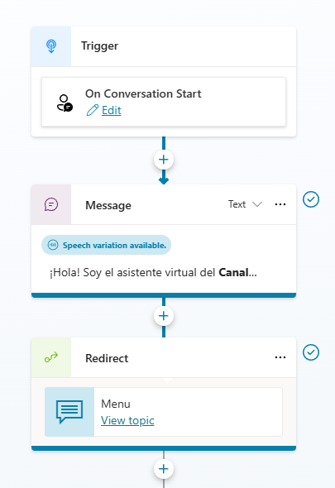
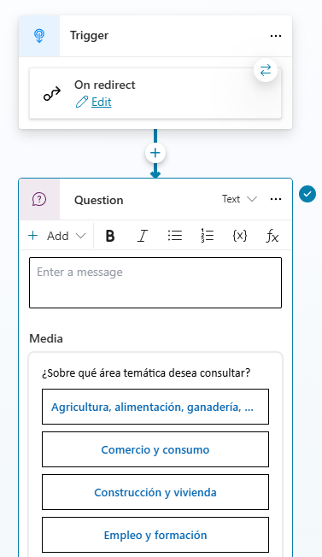
Why do we ask these questions?
Agents may face performance issues when the Conversation Start logic is complex or when the start logic connects and loads data from external systems.
It’s a best practice to make sure the first message sent to the user is delivered as fast as possible for a great conversational experience.
Share your Conversation Start logic
Understanding what the agent does when initially triggered
Example answer (you can delete this)

Slide 54
Why do we ask these questions?
Power Automate offers great integration capabilities, with more 1,000 native connectors or ways to create your own custom connectors to your APIs.
For a good end-user experience, cloud flows triggered from Copilot Studio must execute quickly so that the user doesn’t have to wait too long for the agent to answer.
Cloud flows triggered from Copilot Studio have a maximum of 100 seconds to return to Copilot Studio before they time out.
You can make HTTP requests or use connectors directly from Copilot Studio, to avoid invoking cloud flows and optimize performance.
Useful resources:
Call a flow as an action
Perform HTTP requests
Power Automate Standards by MVP Matthew Devaney
Power Automate and HTTP/Connectors
Leveraging the 1,400+ connectors to extend your agent
How are you optimizing your cloud flows and HTTP/Connector requests to make sure they run as fast as possible?
Do you call cloud flows that don’t have any connector as part of their actions? If yes, why?
How do you handle cloud timeouts and limits (e.g., throttling)?
Example answer (you can delete this)
When connecting to the target system, the query filters the results and only returns the columns that will be used.
Example answer (you can delete this)
No.
Example answer (you can delete this)
Parallel branch in cloud flows to return a result before 100s.
Each connector limit is assessed.
Power Platform requests are accounted for.

Slide 55
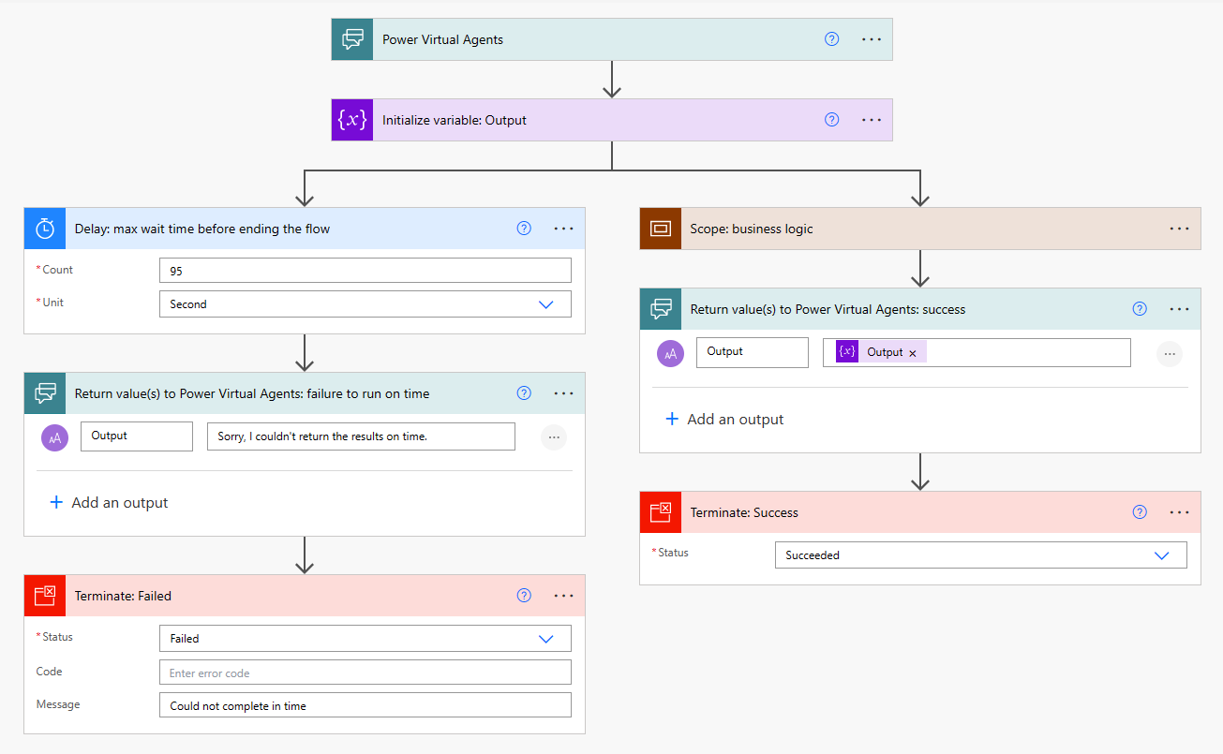
Why do we share this example?
By adding a parallel branch that returns a result to Copilot Studio within 100s, you can more gracefully handle the timeout on the agent side.
Useful resources:
FlowActionTimedOut error code
MVP Matt Jimison's example of handling cloud flow timeouts in Copilot Studio
Handling cloud flow timeouts example #1
Return results to the agent before the 100th second

Slide 56
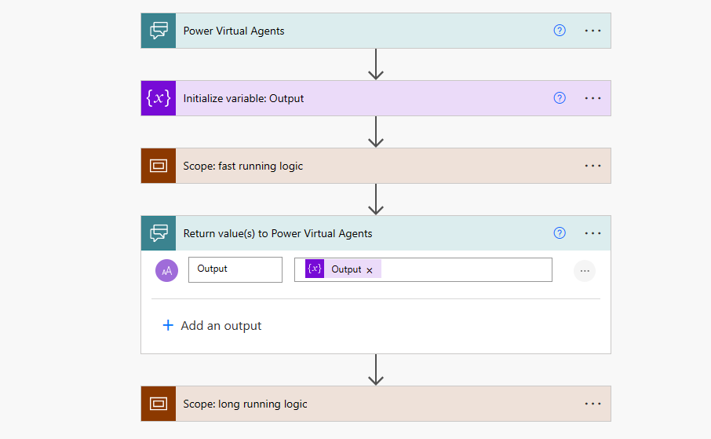
Why do we share this example?
Cloud flows can continue to run after outputs are returned to Copilot Studio.
Place long running logic after the “Return value(s) to Copilot Studio” step.
When deploying to Microsoft Teams, the ‘send proactive message’ message feature could be used to have the bot send the message to the user, once it is ready on the Power Automate side.
Useful resources:
FlowActionTimedOut error code
Notify bot users in Teams with proactive messages
Handling cloud flow timeouts example #2
Return results to the agent and let long-running logic continue

Slide 57
Why do we ask these questions?
Power Automate offers great integration capabilities, with more 1,400 native connectors or ways to create your own custom connectors to your APIs.
For a good end-user experience, custom connectors provide easy to use business functions without requiring web service knowledge from makers.
Custom connectors can be easily created based on existing OpenAPI files or directly from Azure Services or Postman Collections.
Custom connectors support actions as well as triggers (webhooks)
Useful resources:
Custom connectors overview
Custom connectors
Going beyond out-of-the box connectors to integrate you Copilots into custom systems
How are you connecting to custom systems where no connector exists?
Do you call systems directly or through an integration layer (API Management)?
How do expose your systems?
Example answer (you can delete this)
Custom connector for internal REST-based APIs that are isolated in a virtual network.
Example answer (you can delete this)
Direct for atomic integrations. Through API Management for systems with format/credential translation (e.g., SOAP-based services)
Example answer (you can delete this)
REST based web service
REST and SOAP

Slide 58
Channels, clients, and hand off
Deployed channels
Chat clients
Hand off management

Slide 59
Why do we ask these questions?
Copilot Studio deploys to multiple channels natively (Teams, websites, Facebook, Power Pages, Power Apps canvas apps, etc.).
For advanced scenarios such as custom apps or web clients, customers can integrate with the agent’s Direct Line API.
The Direct Line API supports WebSocket, and efficient streaming method to push messages to clients, whereas the HTTP GET interface enables clients to explicitly request messages.
For additional channels, customers would typically setup a relay agent to use Azure Copilot Services channels and potentially use community channel adapters.
Useful resources:
Publish an agent to various channels
Key concepts in the Bot Framework Direct Line API 3.0
Add a Copilot Studio bot to Azure Copilot Service channels
Available Azure Copilot Service channels
Channels and Community / Botkit Adapters
Deployed channels
Overview of all integrations with other systems and expected volumes
Channel & Client | Expected Volume | Details
Example answer (you can delete this)
Teams | 5,000 / month | Deployed as a Teams app to all employees.
Direct Line – Intranet website | 10,000 / month | Deployed using the standard custom website integration.
Direct Line – WhatsApp | 2,000 / month | Azure relay agent + channel adapter connecting to Infobip
Direct Line – Voice | 5,000 / month | Voice channel through 3rd-party AudioCodes

Slide 60
Why do we ask these questions?
There are many available options to deploy an agent interface to users.
Depending on the channel and client, not all Markdown and adaptive card formats may be supported.
Useful resources:
Configure an agent for a live website
Customize the web chat canvas (simple)
Customize and host your own chat canvas (advanced)
Bot Framework Web Chat canvas
Format your bot messages in Teams
Markdown Guide
Adaptive Cards
Deployed clients
List the different clients the for the agent
Client | Details | Client Customization requirements | Message formatting requirements
Example answer (you can delete this)
Default Web Chat canvas | V1 MVP | Simple CSS and JavaScript styling options | Simple markdown 1.5 adaptive cards
Bot Framework Web Chat | V2 for advanced styling and controls | Advanced layout customizations and deeper interactivity with the rest of the web page context. | Custom Adaptive Cards rendering requirements
Genesys Cloud chat client | V3 to add handoff | Logo & brand identity
Teams | For internal teams | N/A
SMS |  | N/A | Text only

Slide 61
Why do we ask these questions?
When requiring hand off to an agent, the chat client must be the one of connected engagement hub, that is placed at the front, and not Copilot Studio. The engagement hub integrates with Copilot Studio through APIs, and that’s how it’s able to take over a conversation from an agent to escalate to a live agent.
A full hand off to an engagement hub follows this pattern:
An end-user interacts with the engagement hub's chat canvas.
The engagement hub routes the incoming chat through routing capabilities.
A custom adapter relays the incoming chat messages to the Copilot Studio agent.
Once the end user triggers hand-off, Copilot Studio starts hand-off with full chat context.
The custom adapter intercepts the hand-off message and context, and seamlessly routes the conversation to an agent.
The end user's chat is handed off to an agent who can resume the conversation.
Useful resources:
Hand off with Dynamics 365 Omnichannel for Customer Service
Hand off conversations to any generic engagement hub
Hand off to a live agent
Copilot Studio lets you hand over agent conversations to a human
Are you handing off conversations to Dynamics 365 Omnichannel for Customer Service? (dedicated section)
Are you handing off conversations to another engagement hub solution? If yes, which one and how?
What chat client are you placing in front of your end-users?
Example answer (you can delete this)
No
Example answer (you can delete this)
Yes, Genesys Cloud through a custom adapter.
Example answer (you can delete this)
Genesys chat widget.

Slide 62







Why do we share this?
The preferred and most standard approach to handle hand off with a live agent is to use the engagement hub chat canvas at the front.
This is how most standard integrations with 1st-party or 3rd-party contact centers are done and made available.
Pros:
Easier to setup without too much overhead (frontend configuration).
Agent messaging and capability maintain full fidelity.
Existing engagement hub capabilities (agent takeover, sentiment analysis, supervisory…) continue to work as-is.
Cons:
No ability to intercept human agent messages upon escalation (unless engagement hub supports an API).
No whisper mode (unless engagement hub supports it)
No control over user experience of responses (messages, cards) emitted from bot.
Useful resources:
Hand off to a live agent
Hand off with Dynamics 365 Customer Service, Genesys, LivePerson, Salesforce Einstein Bot, ServiceNow.
Hand off conversations to any generic engagement hub
Handing off to a live agent
Pattern 1: “bot-as-an-agent” Engagement Hub at the front, Copilot Studio at the back
1
Contact Center
Azure or other
Copilot Studio
Engagement Hub Chat Canvas
Engagement Hub
Adapter (sometimes native with 3rd-party providers)
Copilot Studio Direct Line APIs
3
2
End-user
Live agent
End-user chats with the Engagement Hub chat canvas and an adapter relays messages with a Copilot Studio agent through the Direct Line APIs.
When an escalation event is sent by the Copilot Studio agent APIs, the Engagement Hub takes over the conversation.
A live agent can resume the chat with the end-user.
1
2
3

Slide 63

Why do we share this?
An alternative but more custom and complex approach is to use Copilot Studio at the front and integrate through an engagement hub APIs through a skill.
Pros:
Copilot Studio is always in the loop, including agent messages.
Full control over how responses (messages, cards, etc.) emitted from the bot are shown to end-user.
Agent may be assisted in whisper mode (i.e., agent assist).
Opportunity for the bot to do skill-based routing to the right agent.
Cons:
Engagement hub must be sufficiently extensible to support this pattern.
Many hops between systems.
Requires a pro-dev and PaaS approach for the Bot Framework skill.
Heavy overhead and integrations of the hub with Copilot Studio.
Live agent is limited to using a compatible chat canvas.
No ability for channel provider to customize their agent messages to show up in the canvas.
Agent takeover / supervisor capabilities likely aren’t possible.
Useful resources:
Hand off to a live agent
Use Microsoft Bot Framework skills
Handing off to a live agent
Pattern 2: “bot-in-the-loop” Copilot Studio at the front, Engagement Hub at the back
1
Copilot Studio
Azure AI Bot Service
Contact Center
Chat Canvas
Hand off topic invoking a skill
Microsoft Bot Framework Skill
Engagement Hub & APIs
2
3
End-user
Live agent
End-user chats with the Copilot Studio agent through the chat canvas (the standard one or a custom one that integrates with Copilot Studio standard endpoints).
When an escalation event occurs, Copilot Studio triggers a Bot Framework skill.
The skill relays messages back and forth between the Contact Center live agent and the end-user through the Engagement Hub APIs
1
2
3

Slide 64
Security, monitoring & governance
Security and administration controls
Copilot security configuration
Data loss prevention policies
Tenant and environment security
Authentication & channel security
Single sign-on
Monitoring
Governance
Compliance

Slide 65






Why do we share this?
Data loss prevention (DLP) policies can be configured at tenant-level to apply either to all environments, only specific environments, or all environments except specific ones. DLP policies can enforce agent settings like authentication, and block specific channels, knowledge sources, connectors, etc.
The publishing of agents using generative AI features can be completely blocked at the tenant level.
Useful resources:
Security and governance in Copilot Studio
Enforce DLP policies for Copilot Studio
Exempt an agent from DLP policies
Assign Copilot Studio user licenses
Control user access to environments
Manage app permissions in Microsoft Teams to block the Teams app
Disable self-service trial sign-ups: set AllowAdHocSubscriptions to $false
Share an agent for collaborative authoring
Configure web channel security
Enterprise security with Power Platform
Security and administration controls
Available controls at the Power Platform tenant, environment, or agent level
Copilot Studio features controls
Copilot Studio maker access controls
Data loss prevention (DLP) policies can be enforced to all Power Platform environments to:
Allow/block unauthenticated usage.
Allow/block individual channels.
Allow/block knowledge sources.
Allow/block individual connectors.
Allow/block connecting to skills.
Allow/block integrating with Application Insights.
Allow/block publishing of agents that use generative AI.
Access to the Copilot Studio authoring experience (i.e., copilotstudio.microsoft.com) can be controlled by:
Assignment of a Copilot Studio User license or Microsoft 365 Copilot user license (application), Copilot Author settings for pay-as-you-go.
Allow/block self-service trials for the tenant.
Allow/block access to the Copilot Studio Teams app (i.e., aka.ms/CopilotStudioForTeams)
Tenant
Data loss prevention (DLP) policies can be scoped to include/exclude specific environments.
Allow/block the public data source (i.e., Bing).
For environments with no regional Azure OpenAI capacity, allow/block generative AI features.
Network isolation (virtual network and IP firewall)
Allow/block environment access with security groups.
Allow/block permissions to create, read, update or delete agents through security roles. Dataverse tables:
Copilot (bot)
Copilot Subcomponent (botcomponent)
Conversation Transcript (conversationtranscript)
Environment
Enable/disable generative orchestration at agent level.
Enable/disable AI knowledge at agent level.
Enable/disable generative answers at agent level.
Enable/disable intelligent topic authoring at user level.
Set agent authentication (None, authenticate with Microsoft, and Manual – i.e., app registration)
Enforce Web Channel security at agent level.
Share/unshare agents with other users for authoring.
Users with a System Administrator role can read and update all agents and transcripts.
Agent

Slide 66

Why do we share this?
Entra ID groups should be leveraged to fully drive user license assignment, environment access, and security roles assignment.
You should apply a most-restrictive approach by default and relax requirements on an exception basis.
Useful resources:
Enterprise security with Power Platform
Assign licenses to a group
Control user access to environments
Use group teams to assign security roles
Manage data loss prevention policies
Disable the ability to publish copilots with generative answers and actions
Configure data movement across geographic locations for generative AI
Configure web channel security
Share and collaborate on chatbots
Connecting and authenticating to sources
Use environment variables for secrets
Authentication variables
Pipelines in Power Platform
Activity logging
Customer-managed encryption
Customer lockbox
IP firewall
Virtual networks
Microsoft Entra ID security best practices
Security, agent, & user management
Best practices to secure your Copilot Studio project
Assign licenses to users through Entra ID groups Grant the ‘Microsoft Copilot Studio User’ license to users through a group instead of individual assignment.
Manage user access to environments through Entra ID groups Only bot authors and a just-in-time admins should have access to your environments and data stores.
Manage security role assignment through Entra ID group teams Within each Dataverse environment, leverage group teams to assign security roles to users.
Apply restrictive Data Loss Prevention policies to your environment DLP policies can be applied to your environments to block all connectors that are not required by the project as well as any channel or setting that isn’t useful for the project (e.g., unauthenticated use, use skills, etc.).
Review and only enable tenant, environment and agent settings that are relevant Tenant admins can disable publishing of GenAI-powered bots. Environment admins can disable GenAI features that require data movement outside of their region. Agent authors can require secured access for the web channel. Internal agents can be limited for use by specific groups instead of being available to all.
Review and tighten security of all integrations Connections should require strong authentication. Secrets should be stored in a secure location (e.g., Azure Key Vault). Leverage delegation, impersonation or filtering for data access in the context of an end-user.
Have a gated release process to production Deploying changes from dev to test and to prod should require reviews and be part of a gated process.
Explore additional Power Platform, Dataverse and Entra ID security features E.g., audit logs, customer-managed keys, customer lockbox, IP firewall, network isolation, multi-factor authentication, continuous access evaluation, etc.

Slide 67



Why do we share this?
These security roles grant permissions to Copilot Studio configuration and data tables in Dataverse.
To start creating and working on agents, users can be assigned the standard Environment Maker security role. With this role, users only see their own agents or the agents that have been shared with them. If too permissive, custom roles may also be used.
The Environment Maker role also lets users create other related Power Platform artefacts (e.g., solutions, cloud flows, connection references, environment variables, etc.)
To see transcripts, users must be granted at least one role giving read access to the Conversation Transcript table.
Useful resources:
Use group teams to assign security roles
Security concepts in Dataverse
Copilot (bot) table/entity reference
Copilot subcomponent (botcomponent) table/entity reference
conversationtranscript table/entity reference
Copilot Studio security roles
Overview of standard Dataverse security roles and impact on Copilot Studio
Security Role / Table | Copilot bot | Copilot Subcomponent botcomponent | Conversation Transcript conversationtranscript
System administrator | Org (CRUD) | Org (CRUD) | Org (CRUD)
System customizer | Org (CRUD) | Org (CRUD) | None
Environment maker | User (CRUD) | User (CRUD) | None
Bot Transcript Viewer | None | None | User (Read)
Bot Author (deprecated) | User (CRUD) | User (CRUD) | User (CRU)
Bot Contributor (deprecated) | User (Read) | User (CRUD) | None
Omnichannel administrator | Org (Read) | None | None
How are Copilot Studio records secured in Dataverse?
When an agent is created, a team gets also created and the chatbot is shared with that team.
Copilot subcomponents (e.g., topics, entities, files, etc.) are shared with the same team.
Conversation Transcripts are implicitly shared with their parent agent’s team, but only users that have a read access on the Conversation Transcript table can access them.

Slide 68
Why do we ask these questions?
Understanding your key requirements around security and making sure they are mapped with existing features.
Identify alternatives for scenarios not natively covered.
Useful resources:
Copilot Studio security
Copilot security configuration
Detail your security requirements
Do you have a list of security requirements for your agent? How are you going to implement these?
Example answer (you can delete this)
Enterprise copilots:
Users need to be authenticated using Microsoft Entra ID.
Users need to be automatically signed in.
IPs need to be allow-listed in the corporate firewall.
Need to integrate with internal, on-premises, APIs.
Integrations must use service principals.
Secrets must be stored in key vaults.
Only specific apps should be able to call the agent as a skill.
Citizen-developer copilots:
The unauthenticated configuration need to be blocked on all copilots and all channels.
Copilot usage (inventory and conversations) need to be monitored at the tenant level).

Slide 69
Why do we ask these questions?
Administrators can govern copilots in their organization by using data loss prevention (DLP) policies with specific Copilot Studio connectors.
Channels (Teams, Direct Line, Facebook, Omnichannel), unauthenticated use, knowledge sources, Azure Application Insights, and Bot Framework skills can be allowed or blocked.
Useful resources:
Security and governance in Copilot Studio
Apply data loss prevention policies to copilots
Connector endpoint filtering
Data loss prevention policies
Enforcing security settings as well as exceptions at a global level
How do you ensure that internal confidential data doesn’t get available externally?
Do you plan to use DLP policies to enforce Copilot Studio allowed channels and authentication settings?
Do you plan to use DLP policies to enforce allowed or blocked Power Automate connectors or HTTP requests?
Example answer (you can delete this)
Strong governance of connectors and authentication settings, especially for generative answers data sources.
Example answer (you can delete this)
Yes, by default no unauthenticated copilots are allowed and only the Microsoft Teams channel can be used, to make sure they’re internal.
Example answer (you can delete this)
Yes, with Copilot Studio, only related business applications such as Dynamics 365, ServiceNow and SharePoint are allowed. Endpoint filtering will be used for allowed HTTP APIs.

Slide 70
Why do we ask these questions?
Copilot conversation transcripts are automatically stored in Dataverse.
These can contain sensitive customer information that need to be protected.
Useful resources:
Power Platform security
Microsoft Entra multifactor authentication
Microsoft Entra Conditional Access
Use Azure Key Vault secrets
Just-In-Time Access Management
Manage application users
Manage group teams
Customer Lockbox
Tenant and environment security
Securing access to data
Do you enforce strong requirements for authentication?
How do you control privileged users access to sensitive data?
How do you manage secrets?
Do you use service principals or managed identities?
Do you have network security requirements?
Do you audit and review access periodically?
Multi-factor authentication and conditional access.
Just-in-time access to production.
Azure Key Vault and Environment Variables
Service principals for integrations and deployments.
Some internal APIs are only accessible in a VNET.
Yes, every month. Roles only granted through groups.

Slide 71
Why do we ask these questions?
Authentication allows users to sign in, giving your agent access to a restricted resource or information. Users can sign in with Microsoft Entra ID, or with any OAuth2 identity provider such as Google or Facebook.
With Direct Line-based security, you can enable access only to locations that you control by enabling secured access with Direct Line secrets or tokens.
Useful resources:
Configure user authentication
Configure user authentication with Microsoft Entra ID
Configure web channel security
Authentication & channel security
Authentication requirements
Is the agent working unauthenticated, authenticated, or both?
If yes, what is the authentication service?
Do you need to enforce web channel security?
Example answer (you can delete this)
External agent: hybrid authentication. The public website can start chat sessions and handle FAQ questions unauthenticated, but specific operations require the user to authenticate
Example answer (you can delete this)
Internal agent: “Manual” (AAD) or “Only for Teams and Power Apps”. External agent: “Manual” (Generic OAuth2)
Example answer (you can delete this)
Internal agent: yes.
External agent: no.

Slide 72
Why do we ask these questions?
Copilot Studio supports single sign-on (SSO), which means agents can sign the user in.
SSO needs to be implemented on your web pages, mobile applications.
For Microsoft Teams, SSO is seamless if you select the “Only in Teams” authentication. It can also be configured with Manual Entra ID v2, but in this case the Teams app must be deployed as a zip file, not with the 1-click Teams deployment from Copilot Studio.
Useful resources:
Configure SSO with Entra ID for web/apps
Configure SSO with Entra ID for Teams
Single sign-on (SSO)
Automatic signing in authenticated users
Do you have SSO requirements? How are you going to implement these?
Example answer (you can delete this)
Internal agent:
Teams users and intranet website users must be automatically signed in (Entra ID v2).
SSO must also work on the internal SharePoint intranet.
External agent:
SSO with Generic OAuth 2.

Slide 73
Why do we ask these questions?
In addition to the native analytics features within Copilot Studio, you can send telemetry data to Application Insights.
You can send custom events to Azure Application Insights.
Useful resources:
Capture Copilot Studio telemetry with Azure Application Insights
Set up Application Insights with Power Automate
Monitoring
Capture telemetry, measure performance, and setup alerts with Application Insights
How do you plan to technically monitor your agents?
How do you plan to technically monitor your integrations and cloud flows?
Do you have other technical monitoring requirements and plans?
Example answer (you can delete this)
Azure Application Insights to log activities, errors, and custom events. Also used to monitor Generative Answers and details on failed or moderated answers.
Example answer (you can delete this)
Azure Application Insights for cloud flows.
Example answer (you can delete this)
Yes, the agent client load time on the web page will be monitored with our web analytics tools.

Slide 74
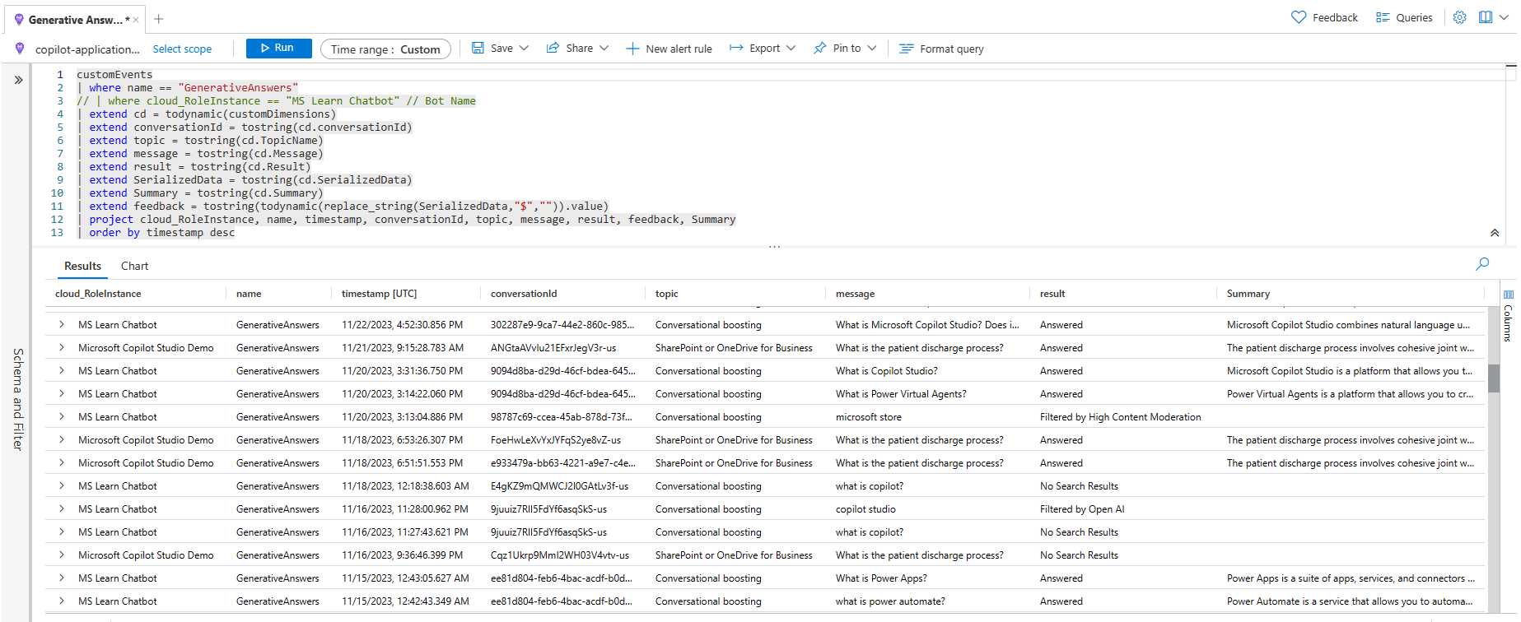
Azure Application Insights example
Monitoring generative answers results and moderation
customEvents
| where name == "GenerativeAnswers"
// | where cloud_RoleInstance == "MS Learn Chatbot"
| extend cd = todynamic(customDimensions)
| extend conversationId = tostring(cd.conversationId)
| extend topic = tostring(cd.TopicName)
| extend message = tostring(cd.Message)
| extend result = tostring(cd.Result)
| extend SerializedData = tostring(cd.SerializedData)
| extend Summary = tostring(cd.Summary)
| extend feedback = tostring(todynamic(replace_string(SerializedData,"$","")).value)
| project cloud_RoleInstance, name, timestamp, conversationId, topic, message, result, feedback, Summary
| order by timestamp desc

Slide 75
Why do we ask these questions?
As customers expand their use of Microsoft Power Platform to enable citizen developers across their organizations, they also seek capabilities to govern and monitor usage.
The Microsoft Power Platform CoE Starter Kit is a collection of components and tools that are designed to help organizations develop a strategy for adopting and supporting Power Platform.
CoE Starter Kit features for Copilot Studio
Keep track of the number of conversations per agent over time, with daily aggregates.
Allocate a number of conversations per environment
Receive capacity email alerts when environment add-ons get near or over their allocated number of conversations.
Get an overview dashboard of Copilot Studio usage in a tenant over time as well as an all-up conversation consumption versus allocation.
Useful resources:
Center of Excellence Starter Kit with Copilot Studio: Govern, Monitor and Manage
Governance
How to you govern Copilot Studio at scale?
Do you plan to use the Center of Excellence Starter Kit to monitor your agents in your tenant?
Do you have specific governance requirements?
Do you allow users to create copilots using Copilot Studio for Teams? Do you allow users to create Copilot Studio trials?
Example answer (you can delete this)
Yes, the central CoE team already uses the Starter Kit to monitor Power Apps and Power Automate. Copilot Studio monitoring will allow track usage across copilots and environments.
Example answer (you can delete this)
As capacity is purchased globally and pooled at the tenant level, tenant-wide analytics are required to implement a charge-back model.
Example answer (you can delete this)
No, Copilot Studio for Teams is blocked as an app in Microsoft Teams. Trials of Copilot Studio are blocked, and users need a license to create copilots.

Slide 76
Why do we ask these questions?
Microsoft complies with data protection and privacy laws applicable to cloud services. Our compliance with world-class industry standards is verified.
Environments can be created in specific regions, even if different from the region the tenant resides in.
By default, conversation transcripts are only kept for 30 days in Dataverse. This can be updated on per-environment basis.
Useful resources:
Copilot Studio compliance offerings
Copilot Studio GDPR compliance
Copilot Studio Data Locations
Managing compliance in the cloud
Service Trust Portal
Change the default retention period for conversation transcripts
Move data across geographic locations for generative AI features outside United States
Compliance
Understand how regulatory requirements impact your project
What the regulatory requirements and norms you need to comply with?
Do you have hard requirements as to where the data must be located?
Do you have other compliance requirements?
Example answer (you can delete this)
GDPR compliance.
Example answer (you can delete this)
Data location and processing must stay within the European Union boundary.
Example answer (you can delete this)
Transcripts must be kept for 2 years in a compliant location.
Sensitive data must be obfuscated from transcripts

Slide 77
Application Lifecycle Management
Application Lifecyle Management example
ALM strategy
Environments
Capacity
Test strategy
Training
Run & maintenance

Slide 78










Why is ALM important?
Copilot Studio ALM is based on the broader Power Platform ALM principles.
They use the concept of solutions to package and deploy customizations.
What are ALM golden rules?
Work in the context of solutions
Create separate solutions only if you need to deploy components independently.
Use a custom publisher and prefix.
Use environment variables for settings and secrets that change across those.
Export and deploy solutions as managed, unless setting up a dev environment.
Don’t do customizations outside of dev.
Consider automating ALM for source control and automated deployments.
What needs to be set manually?
Azure Application Insights integration.
Deployed channels.
Some security settings.
Useful resources:
Use environment variables
Power Platform ALM
Power Platform pipelines
Azure DevOps Power Platform Build Tools
GitHub Power Platform Actions
ALM Accelerator for Power Platform
Bulk test with the Copilot Studio Kit
Application Lifecyle Management
Safely deploy customizations across environments and keep track of changes.
Example solution configuration
Development
Test
Q.A.
Production
1.0
1.0
1.0
1.0
Agent
Contoso Agent
Agent Components
Agent
Contoso Agent
Agent Components
Agent
Contoso Agent
Agent Components
Agent
Contoso Agent
Agent Components
1.2
1.1
1.1
1.1
Cloud Flows
ServiceNow Flow
Internal API Flow
Cloud Flows
ServiceNow Flow
Internal API Flow
Cloud Flows
ServiceNow Flow
Internal API Flow
Cloud Flows
ServiceNow Flow
Internal API Flow
1.3
1.3
1.3
1.2
Connectors & Variables
Connection Reference
Env. Variables
Custom Connector
Connectors & Variables
Connection Reference
Env. Variables
Custom Connector
Connectors & Variables
Connection Reference
Env. Variables
Custom Connector
Connectors & Variables
Connection Reference
Env. Variables
Custom Connector
Learn from agent usage in production to make improvements in dev for future releases
Automate
Evaluate options from simple to advanced continuous integration & delivery (CI/CD)
Manual deployment of solutions
Automated deployment with user-friendly pipelines in Power Platform (no source control)
Automated deployment + source control with Azure DevOps or GitHub Power Platform tools.
Use of the ALM Accelerator for #2 + #3 and advanced deployment options for both no-code and pro developers.
Automated testing of the agent as part of the deployment process.
Test

Slide 79
Why use component collections?
A component collection is a collection of reusable agent components. Components include topics, knowledge, actions, and entities.
The main benefit of component collections is that you can share component collections between multiple agents within your environment.
Because you can also use a solution to export and import component collections to move their content across multiple environments to meet your application lifecycle management (ALM) scenarios, this means you can have parts of your agents developed in multiple environments, by multiple teams, and with their own release cadence.
Useful resources:
Create reusable component collections
How To Use Component Collections in Copilot Studio (video)
How To Use Component Collections & Solutions To Distribute Reusable Assets for Copilot Studio (video)
Component collections
Multiple development environments and teams working on different parts of the agent
Example solution and component collection configuration
IT and HR DEV Environment
Contoso DEV
Environment
Contoso TEST
Environment
Contoso PROD
Environment
1.1
1.1
1.0
Contoso Agent
Contoso Topics
Contoso Actions
Contoso Knowledge
Contoso Agent
Contoso Topics
Contoso Actions
Contoso Knowledge
Contoso Agent
Contoso Topics
Contoso Actions
Contoso Knowledge
1.5
1.5
1.4
1.3
IT Collection
IT Topics
IT Actions
IT Knowledge
IT Collection
IT Topics
IT Actions
IT Knowledge
IT Collection
IT Topics
IT Actions
IT Knowledge
IT Collection
IT Topics
IT Actions
IT Knowledge
1.3
1.3
1.3
1.3
HR Collection
HR Topics
HR Actions
HR Knowledge
HR Collection
HR Topics
HR Actions
HR Knowledge
HR Collection
HR Topics
HR Actions
HR Knowledge
HR Collection
HR Topics
HR Actions
HR Knowledge
The Contoso Agents references topics, actions, and knowledge from the HR and IT collections.

Slide 80
Why do we ask these questions?
It’s key to have a healthy ALM process to avoid production issues and catch and fix any regression early.
Useful resources:
Power Platform ALM
Use segmented solutions
ALM Strategy
Detail your CI/CD processes
How to you deploy your customizations, variables and connections?
How do you organize your solutions?
Do you source control your customizations?
Example answer (you can delete this)
Deployment are done using Azure DevOps pipelines and managed solutions. Environment variables are used for settings and secrets. Connections are configured by a service account.
Example answer (you can delete this)
A single solution with the agent, cloud flows, connection references, environment variables. A single publisher, “Contoso” (cto_) is used.
Example answer (you can delete this)
Azure DevOps. Pull requests require peer reviews before customizations are merged into the main branch and deployed to downstream environments.

Slide 81
Why do we ask these questions?
Knowing your tenant, environment, and agent ids can be useful for proactive monitoring.
Understanding how you setup your environments is also important in relation with your ALM processes.
The region can be meaningful for releases and availability of certain features.
It’s a best practice to limit access to an environment to the specific members of a Microsoft Entra ID security group.
Useful resources:
Create and use environments
Control user access to environments
Environments
List the different environments and copilots for your project
Tenant ID
8a235459-3d2c-415d-8c1e-e2fe133509ad
Name | Type | Region | Required apps | Environment Id | Agents(s) and Bot Id(s)
Example answer (you can delete this)
Contoso DEV | Sandbox | Europe | D365 + OC Voice | 7f8448e4-b056-e6f9-a235-ddec0aa85c0d | Contoso Copilot cb093eb6-ec05-ee11-8f6e-000d3a5c61dd
Contoso TEST | Sandbox | Europe | D365 + OC Voice | 47378d94-f56c-eed0-b8cd-89d17d7e31b3 | Contoso Copilot d182abc5-7335-ee11-bdf4-000d3a37044a
Contoso QA | Sandbox | Europe | D365 + OC Voice | 20bb12c3-1a5c-e8ff-b0f7-4f32adef8616 | Contoso Copilot 64c03bd0-04c4-499a-8fa6-77de5d1d27aa
Contoso | Production | Europe | D365 + OC Voice | c53bf002-7923-4d1c-b5ae-3265093d59e1 | Contoso Copilot 65d3b807-8cd7-4b58-afae-768ecd914db7

Slide 82
Why do we ask these questions?
Understanding what you have purchased in terms of capacity for the project.
Potential impact of design on capacity and licensing. E.g., keeping conversation transcripts will grow database storage.
Additional services, such as Azure AI Foundry and AI Search (if used as the Azure AI Search knowledge source in generative answers, or as a custom model for summarization), Data Lake (if used to store conversation transcripts) or Application Insights (to log additional telemetry) require an Azure subscription.
Power Automate cloud flows owned by a service principals require a Power Platform Process license. If owned by a user, they’re covered for premium connectors and come with a base capacity of 250,000 requests per month.
Useful resources:
Assign user licenses and manage access
Quotas in Copilot Studio
Licensing overview for Power Platform
Copilot Studio pricing
Power Automate pricing
Power Platform Licensing Guide
Azure OpenAI Service pricing
Azure AI Search pricing
Azure Data Lake pricing
Azure Application Insights pricing
Licensing & capacity
Aligning product, user licenses & add-ons to technical and business requirements
Product | Quantity | Capacity | Comments
Copilot Studio User
Copilot Studio Messages
Dataverse Database Storage
Dataverse File Storage
Dataverse Log Storage
Power Platform Requests
Power Automate Process
Azure AI Foundry | P1
Azure AI Search Service
Azure Storage
Azure Application Insights
Example answer (you can delete this)
50 | 50 users | For Copilot Studio bot authors
100 | 2,500,000 messages / month | To allocate per environment
50 | 50 GB | + 10 GB Database base capacity
5 | 5 GB | + 20 GB Database base capacity
5 | 5 GB | + 2 GB Database base capacity
1 | 50,000 requests / 24h | + 250,000 requests / 24h base capacity
4 | 4 processes / month | To run flows with service principals
1 | Standard | 1 gpt-4o model
1 | Basic Tier | 1 Replica, 1 Partition, 1 Search unit
1 | StorageV2 | RA-GRS

Slide 83
Why do we ask these questions?
Understand your plans to validate that your agents and integrations work as expected.
Useful resources:
Bulk test with the Copilot Studio Kit
How To Use Copilot Studio Kit for Test Automation (video)
Test strategy
Test plan and non-functional requirements
What is your test strategy for your agents and integrations?
Do you have non-functional requirements?
Example answer (you can delete this)
Use of the Copilot Studio Kit to bulk test user utterances and validate that the appropriate topic triggers or that the first ‘did you mean’ option is the correct one in 90% of the time and validate that generated answers meet expectations.
Example answer (you can delete this)
Chat widget on the website should load and start the conversation in less then 5 seconds when clicked.
Cloud flows triggered to return information to the user need to return the desired data in a maximum of 10s.

Slide 84
Analytics & KPIs
Engagement and outcomes
Analytics strategy
Optimization strategy

Slide 85



Welcome, I’m a virtual agent. You can ask me about our stores and policies.
The virtual agent greets the user with the Conversation start topic.
Hi!
User triggers the Greeting topic.
Hello, how can I help you?
When are you opened?
Conversation design & outcome tracking
User triggers the Store Hours topic.
Our store is open from 8am to 6pm, Monday to Saturday.
Did that answer your question?
Because the query is assumed to be addressed, the virtual agent redirects the user to the End of Conversation topic.
Yes
Great! Please rate your experience
Through multiple questions, the user:
Confirms resolution.
Provides a CSAT score.
Is offered to ask new questions.
Thank you. Can I help with anything else?
Yes, what is your address?
User triggers the Store Locations topic, leading to a new session and outcome.

Slide 86
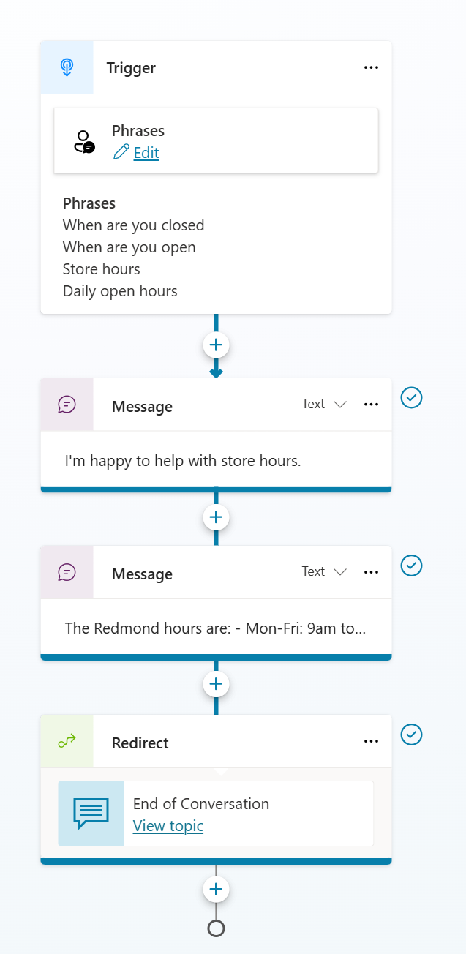
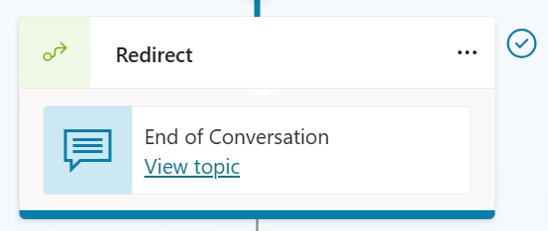
When designing conversations, finish the flow with a redirect to the End of Conversation topic.

Slide 87
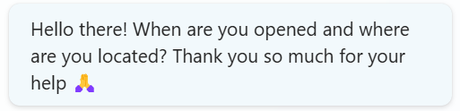
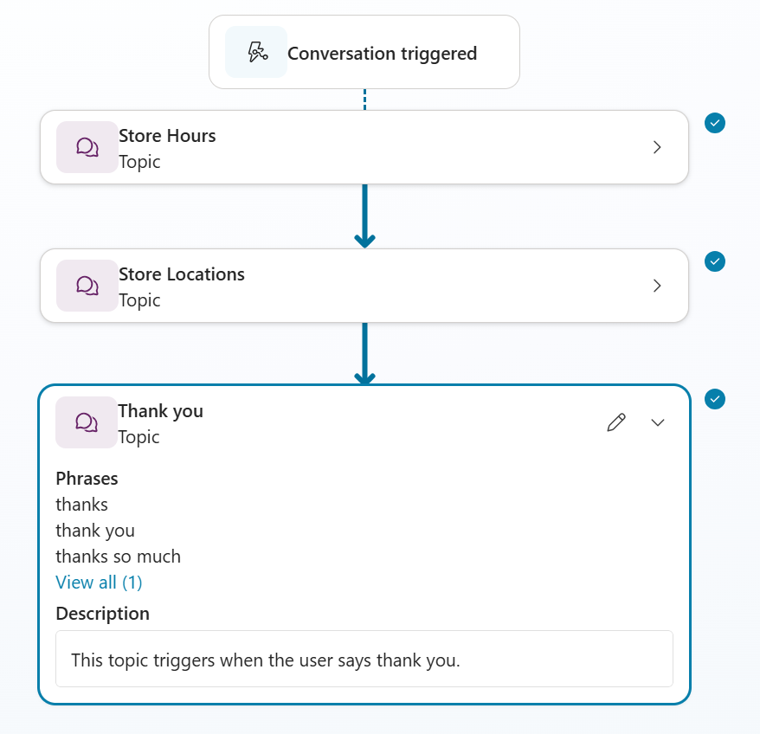
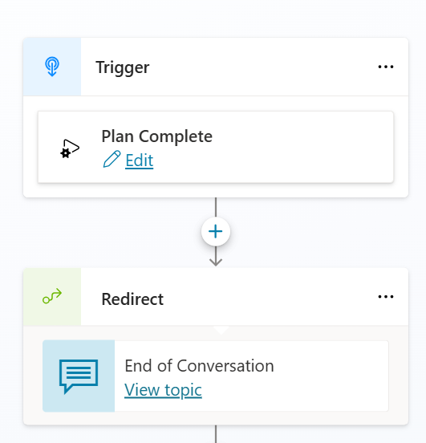
With generative orchestration, multiple intents can be detected and handled at once, by chaining topics and actions together.
Leverage the Plan Complete trigger to redirect to End of Conversation.

Slide 88
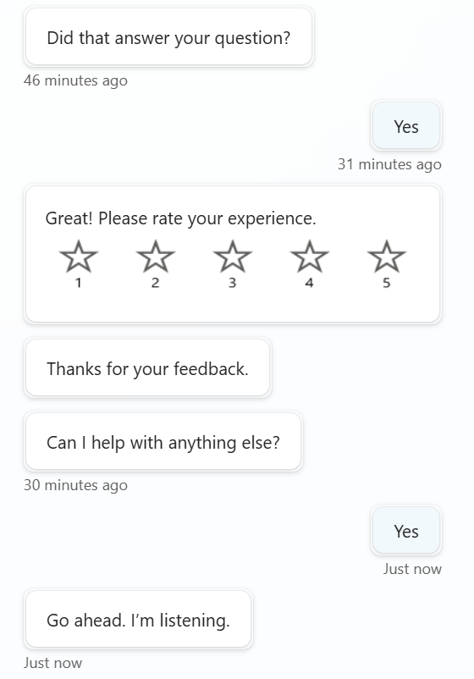
The End of Conversation topic is customizable. It doesn’t have to be ugly or complex for your users.

Slide 89
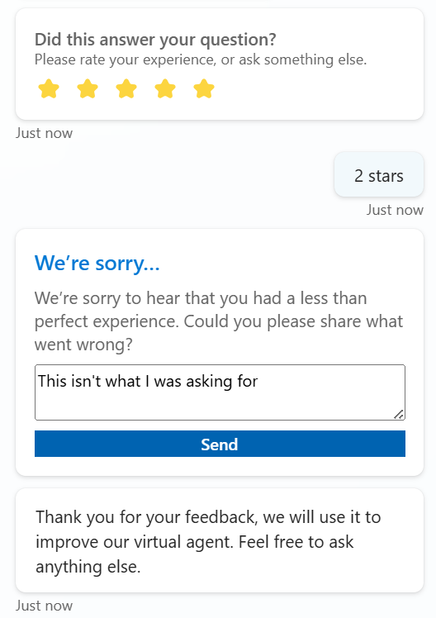
You can go a long way with Adaptive Cards and a good conversation design.

Slide 90
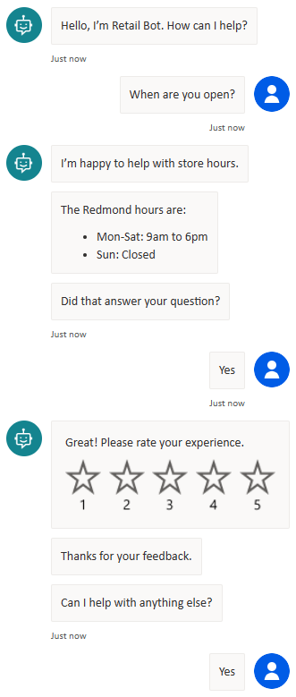
Why do we ask these questions?
Tracking conversation engagement and outcomes is crucial to measure the agent performance metrics and spot areas for improvements in the analytics dashboard.
A single conversation with an agent can generate one or multiple sessions.
A conversation can have multiple sessions when a user has new questions after the End of Conversation topic is reached (4️⃣).
Sessions are either Unengaged or Engaged. Unengaged session’s outcome is None.
A session is engaged (1️⃣) by either triggering a custom topic, the Escalate, Fallback, or Conversational Boosting topics.
Engaged sessions outcome can either be:
Abandoned
Resolved
Escalated
It’s important to end conversation with the End of Conversation topic (2️⃣) so that the end-user can confirm their query was resolved or not (and potentially escalate).
The Confirmed Success path displays a CSAT survey (3️⃣) to capture a 0-5 score.
A conversationOutcome can also be set at the node level in the YAML code editor view, but the End of Conversation topic must then be traversed to be taken into account.
Useful resources:
Key concepts – Analytics
Measuring agent engagement
Measuring agent outcomes
Engagement and outcomes
How do you track engagement rates & session outcomes?
1️⃣
Example answer (you can delete this)
Every conversation path, including Generative Answers ones, end with the End of Conversation topic.
End of Conversation topic is customized to make the resolution validation as simple as possible for the end-user.
Conversation outcomes are also set at specific node levels (in the YAML).
2️⃣
3️⃣
4️⃣

Slide 91
Why do we ask these questions?
Copilot Studio provides comprehensive out-of-the-box analytics that allow customers to understand an agent's usage and key performance indicators.
Customers can view reports related to:
Performance and usage.
Customer satisfaction.
Session information.
Topic usage.
Top knowledge sources.
However, there are often scenarios where you'll need to create or use custom analytics. For example, you may need to:
Share analytics with non-makers or users.
Report on conversation transcripts data for a period longer than the default last 90 days.
Design a report not covered by out-of-the-box analytics.
Useful resources:
Custom analytics strategy
Copilot Studio Kit to ease the creation of custom analytics dashboards
Analytics strategy
Detail your strategy to monitor your agent key performance indicators
Do you have an analytics strategy? Do you plan to develop your own custom analytics? If you are going to create your own reports, please detail how and where you plan to store the data.
Example answer (you can delete this)
Initially, only a few set of KPIs will be defined for the agent success, essentially the engagement rate, resolution rate and the defection rate.
In phase 1, assess the native dashboards, even though they’re limited to 90-day of data.
In phase 2, develop a Power BI report consuming the agent and Conversation Transcript data directly from Dataverse. This will also be the opportunity to enrich agent data with other business metrics such as sales or website traffic.
In phase 3, move data to cheaper long-term storage option (e.g., Azure Data Lake) and update the Power BI report to point to these storage points.

Slide 92
Why do we ask these questions?
Return on investment (ROI) and improved customer satisfaction (CSAT) are top priorities for the organizations that implement Copilot Studio copilots.
Optimizing the agent deflection rate is one of the top focus areas for organizations to achieve their business goals around ROI and CSAT, and to improve the agent's overall performance. There are major indicators in Copilot Studio that help improve agent performance, such as resolution rate, escalation rate, and CSAT.
While the metrics continue to evolve, there are several things you can do as an agent builder to improve the deflection rate of your agent. In these articles, we cover the importance of deflection in conversational AI and general techniques/considerations that are universal for optimizing deflection for copilots.
Useful resources:
Deflection optimization
Optimization strategy
What is your plan to keep improving your agent’s performance and ROI?
Detail your strategy to regularly improve your agent
Example answer (you can delete this)
Monthly review of the agent performance
Deflection rate
Resolution rate
Engagement rate
Topics with low resolution
Unrecognized utterances
Analysis per channel
This review helps prioritize the backlog of agent updates. For example, unrecognized utterances are used to either train existing topic or create new topic where there is demand.

Slide 93
Gaps & top requests
Gaps
Top requests

Slide 94
Why do we ask these questions?
Help us prioritize our future investments by flagging gaps and submitting feature requests.
Detailing the business impacts for your organization helps build a business case for them.
Useful resources:
aka.ms/CopilotStudioFeatureRequest
Gaps
What are the main feature gaps you have identified
Gap #1
Gap #2
Gap #3
Example answer (you can delete this)
No native first-party IVR without Dynamics 365 Omnichannel Voice
Example answer (you can delete this)
No native integration with WhatsApp
Example answer (you can delete this)
Pro-code is required for a SharePoint integration with single sign-on support.

Slide 95
Why do we ask these questions?
Help us prioritize our future investments by submitting feature requests and detailing the business impact they have for your organization by using the link below.
Useful resources:
aka.ms/CopilotStudioFeatureRequest
Top requests
What are the top gaps, feature requests, and priorities?
Request #1
Request #2
Request #3
Example answer (you can delete this)
P1: native file upload support by end-users to upload pictures that are then analyzed with OCR.
Example answer (you can delete this)
P1: support for right-to-left languages Arabic and Hebrew.
Example answer (you can delete this)
Ability to disable adaptive card buttons once they have been actioned.

Slide 96
Dynamics 365 Omnichannel for Customer Service (optional)
Chat widget integration & customizations
Omnichannel hand-off
Unified Routing Configuration
Note: it is expected for Dynamics 365 Omnichannel for Customer Service to have an extended implementation review, typically with FastTrack teams. This chapter calls specific items which are important for the Copilot Studio and Omnichannel integration.

Slide 97
Why do we ask these questions?
Within Dynamics 365 Omnichannel for Customer Service, there is a customized Copilot Studio chat widget which is utilized rather than the native Copilot Studio widget without Dynamics 365 Omnichannel. This customized out-of-the-box widget is a component that Dynamics 365 customers can utilize to get a greater number of options to tailor the widget without having to spend a lot of time on the configuration every single time.
Some of these options include the design but also include functionality like business hours and even channel specific behavior like persistent chat experiences.
Ensure you have reviewed these options within the chat widget
Additionally, ensuring you take into consideration the connection experience between Copilot Studio and Omnichannel in the ‘Agent Hand-off’ area of the Copilot Studio portal, and track your environments based on your environment structure, as well as the agent users within each environment
Useful resources:
Configure the chat widget
Develop a custom live chat widget
Omnichannel Live Chat Widget SDK
Chat widget integration & customization
How are you modifying the chat widget in Dynamics 365 Omnichannel?
Please describe the planned use of the chat widget. Do you plan to develop a custom version of the widget? Do you have other client requirements for specific channels? What your expectations for the widget load time and first message display? How are you making sure the first message is fast?
Example answer (you can delete this)
Use of the LCW v2 configured with the brand theme.
Many context variables, including web page, user ID, locale, etc. must be passed from the website to the chat widget.
Widget and first message should load in less than 5 seconds.
Internal mobile app teams are also looking to integrate their native app with Omnichannel through APIs.

Slide 98
Why do we ask these questions?
You can directly use the ‘Escalate’ system topic to be able to escalate to a live agent in Dynamics 365 Omnichannel within Copilot Studio.
Make sure you consider the experience of both the user and the agent when designing this functionality.
Consider what data you wish the Dynamics 365 Omnichannel agent to receive from the agent when a handover is successfully taken place e.g., data passed to the agent.
Useful resources:
Configure the Copilot Studio agent
Copilot Studio & Omnichannel hand-off
Connect your Copilot Studio agent to Dynamics 365 Omnichannel
Which topics within will link to the ‘Escalate’ topic? Do you need to extend the ‘Escalate’ topic? If so, how and why? Would you be utilizing both the ‘Escalate’ and ‘Fallback’ topic? Have you considered what the waiting experience for a handover to Dynamics 365 looks like and any limitations of the default experience?
Example answer (you can delete this)
Standard behavior will be maintained to escalate.
Over the voice channel, DTMF key 0 will escalate to a live agent.
Fallback topic will not be used over the voice channel but will be used on the website: generative answers will be used before the user can escalate.

Slide 99
Why do we ask these questions?
Unified routing is critical because within Dynamics 365 Omnichannel this is how an agent, or a user, is routed to another queue.
Consider expanding on this slide by creating a routing diagram that can be used to describe the simple routing experience you are proposing on using.
This would help identify any gaps or dependencies.
Useful resources:
Overview of unified routing
Unified routing configuration
How is your agent being routed?
Have you considered the routing experience when an agent escalates a conversation? Which queue is it being routed to? You may have a blueprint where the agent is escalated but re-directed to another agent, for example in another language. How are you differentiating this routing (e.g., conditions) managing those variables, and also managing a true escalate to human experience?
Example answer (you can delete this)
Only one queue and support team.

Slide 100
Why do we ask these questions?
To route customers call to the best department, diagnose issues, collect information, and give recommendations, conversational IVR copilots speak to customers when they call in. Copilot Studio makes it easy to author IVR copilots and you can use the same copilots for other channels, like chat and voice.
It’s important that the implementation of Voice with Copilot Studio as an IVR is well planned and expectations appropriately set.
Useful resources:
Voice channel in Omnichannel
Configure Copilot Studio bots for voice
Use SSML to customize speech responses
Omnichannel Voice integration
Using Copilot Studio as an Interactive Voice Response (IVR)
Do you plan to use Omnichannel Voice? If yes, please detail how. Do you plan to have different conversation paths and formats, or even copilots based on the channel? How are you planning to test it in real-life scenarios? (E.g., with background noises, etc.) Do you have specific requirements for the voice channel? (E.g., DTMF, barge-in, silence detection…)
Example answer (you can delete this)
Omnichannel Voice is used.
Conversations and messages in general are designed to be shorter for the voice channel.
Topics will have branching logic based on the channel.
DTMF options are offered as much as possible, to navigate menus and to provide client IDs.
Tests will be performed by group of pilot users testing in real-life conditions.
Silence detection, barge-in, noise cancelation, are crucial for the voice channel success.

Slide 102
Learn more
Get started today
Copilot Studio website | aka.ms/CopilotStudio
Blog | aka.ms/CopilotStudioBlog
Demo | aka.ms/CopilotStudioDemo
Product documentation | aka.ms/CopilotStudioDocs
Product guidance | aka.ms/CopilotStudioGuidance
Implementation guide | aka.ms/CopilotStudioImplementationGuide
Community page | aka.ms/CopilotStudioCommunity
aka.ms/TryCopilotStudio

